Slide 1

Lymphedema Treatment Act 2024
Linda Roherty, PT, CLT
Klose Training Senior Instructor
May 1, 2024

Slide 2

LTA 2024
58 million Americans are on Medicare
5% of Medicare recipients have some type of lymphedema
3 million Americans have not been covered for compression products for their Lymphedema prior to the LTA

Slide 3
LTA 2024
LTA has been 13 years in the making
LTA bill that was passed in Congress in Dec 2022 and it took a year to become live January 1, 2024
Medicare now recognizes Lymphedema as a valid medical condition that requires medical care
LTA has opened up coverage for day and night compression products and compression bandages, for patients that have not had prior to Jan 2024

Slide 4

LTA 2024
One year is not enough time to create lymphedema category, codes, policy, billing guidelines….confusion still exists

Slide 5
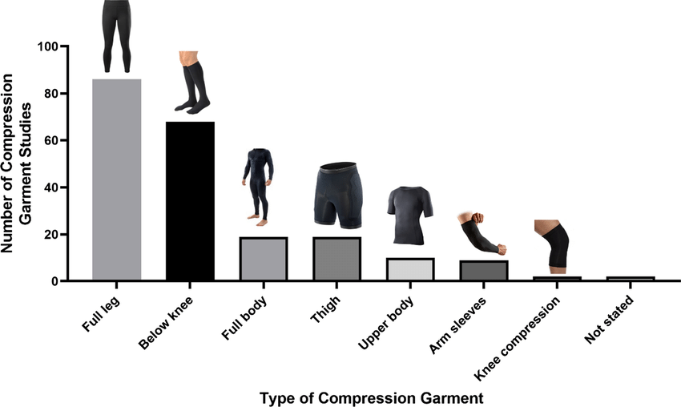
LTA 2024
Compression products are not free
Garments are now billable to Medicare per policy
Medicare, pts are covered at 80%
Patients are responsible for the 20%
Secondary or supplemental Medicare Plans should help cover the 20%
ResearchGate

Slide 6
LTA 2024
Medicare Replacement Plans:
Are reimbursing/covering differently
It is a case by case basis (per the patient’s plan) and should have pre-authorized first from DME to find out what is covered
Some plans cover LESS than the cost of the products
The LTA only directly mandates Medicare coverage
“The LTA will indirectly benefit all patients, because almost all other insurance plans follow Medicare coverage guidelines”
“During the 12 years it took to pass the LTA, private insurance plans increasingly aligned their coverage with that of Medicare’s, with many citing this as the reason for changes to their coverage”
FAQ Document for the Lymphedema Treatment Act

Slide 7
LTA 2024
Daytime garments – 3 sets (one garment for each affected body part) every six months, standard or custom fit, or a combination of products
Velcro products fall into day time
H&N fall into day time products
Nighttime garments – 2 sets (one garment for each affected body part) every two years, standard or custom fit, or a combination
Bandaging supplies – no set limit in the rule (Phase 1 or 2 CDT)
Accessories – No set limit, will be determined on a case-by-case basis depending on the needs of the patient

Slide 8
WE NEED TO DO OUR PART
For years we have given Medicare patients what they can afford..
Today we can give our patients what they deserve to manage their lymphedema

Slide 9
LTA 2024
Diagnosis / ICD 10 Code:
List one of the four diagnosis codes in your evaluation
Do not list other edema codes/only list one of these 4 dx codes)
I89.0 Lymphedema not elsewhere classified
I97.2 post mastectomy lymphedema syndrome
I97.89 other post procedural complications and disorders of the circulatory system, not elsewhere classified
Q82.0 Hereditary lymphedema

Slide 10
LTA 2024
Stage of Lymphedema per John Hopkins Stages:
Patient is Stage __ of the ___________ affected body part.
Stage 1: Abnormal flow in the lymphatic system. No signs or symptoms.
Stage 2: Accumulation of fluid with swelling.
Stage 3: Permanent swelling that does not resolve with elevation.
Stage 4: Elephantiasis (large deformed limb), skin thickening with “wart-like” growth and extensive scarring

Slide 11
LTA 2024 –Standard Gradient Compression
Product Selection:
Qualify if this is a Day Time or Night time Gradient Compression Garment.
Is this a Standard Gradient Compression / off the shelf
Manufacture: Jobst, Juzo, Medi, L&R, Sigvaris, Wear Ease, Prairie Wear….
Limb: Left, Right, Bilateral
Style: Arm sleeve, glove, gauntlet, toe cap, knee high, thigh high, bike short, panty hose….
Size: 1, 2, 3, 4, 5, 6 other or Small, Med, Large
Length: Regular, long, petite, short
Compression class: 15-20 mmHg, 20-30 mmHg, 30-40 mmHg Do not list CCL1, 2..
Options: Silicone band 2.5cm; Silicone band 5 cm; pull up loops, other..
Color: Beige, black, other_________
Donning aid: yes, no. Yes what type:__________
Quantity needed: 1, 2, 3 (every 6 months, per body part) day time and 2 every 2 years for night time
Why does the pt need this product: specifics on why the pt needs it and also why the options are listed

Slide 12
LTA 2024-Made to Measure (custom)
Product Selection:
Qualify if this is a Day Time or Night time Gradient Compression Garment
This a Made to Measure custom garment
Manufacture: Jobst, Juzo, Medi, L&R, Sigvaris, Wear Ease, Prairie Wear….
Limb: Left, Right, Bilateral
Style: Arm sleeve, glove, gauntlet, toe cap, knee high, thigh high, bike shorts, panty hose…
Size: Per made to measure
Length : Per made to measure
Compression class: 15-21 mmHg; 23-32 mmHg, 34-46 mmHg….Do not list CCL1, 2..
Options: Silicone band 2.5cm; Silicone band 5 cm; pull up loops, comfort zone, t-heel, other..
Color: Beige, black, other_________
Donning aid: yes, no. Yes what type:__________
Quantity needed: 1, 2, 3 (every 6 months, per body part) day time and 2 every 2 years for night time
Why does the pt need this product: specifics on why the pt needs it and also why the options are listed

Slide 13
Justify your “why”
Explain “why” your patient needs this product:
Lymphedema is a chronic condition; non-curable: needs to be managed with proper compression gradient products day and night time; reduce progression of disease; reduce cellulitis infections….
Pt with Stage __ lymphedema and needs constant management of lymphedema with_____
Pt requires finger spacers in night time compression to allow compression on each individual finger and prevent finger maceration
Comfort Zone / Functional Zone at knee is needed to allow pt to preform daily work duties of _________ and prevent knee irritation

Slide 14
Example of “why”
This patient with I97.2 post mastectomy lymphedema with moderate Stage III Lymphedema (John Hopkins Staging), in left Upper extremity. Patient will need custom flat knit Jobst Elvarex compression garment sleeve and Elvarex Plus glove, both CCL 2 23-32mmHg. Patient will need 5cm silicone band on top to assist with holding compression sleeve in place. Comfort Zone on elbow to allow ease of elbow motion for ADL's and functional activity. Due to severity and recurrent infections (3-4 per year) and lymphedema being a chronic condition, patient will need a L&R night time Tribute original profile, with Chevron channels. Patient will require pull up loops to allow ease of donning and independence of donning. Due to hand and finger lymphedema patient will need finger spacers to allow for compression on fingers with Tribute product.

Slide 15
LTA 2024
Physician’s referral needs to match what you are ordering with:
Diagnosis Code (the same ICD-10 as on your evaluation)
Compression Product(s)
  Body Part (ie: left arm and hand)
  Style of product (ie: Juzo Strong 18-23 mmHg)
  Options (2.5cm silicone)
  Quantity (Day: 3 every 6 months / Night: 2 every 2 years)

Slide 16

FACTS:
This is what we know today, this will change
We have not had 6 months to know how the reorder will go
Yes it takes longer to get products
  This is new to every DME/Therapist/Patient
    Be patient / be as thorough as possible with your documentation
    Do your part
  Not every DME has taken Medicare Assignment, meaning the pt will have to pay and wait for reimbursement

