Slide 1
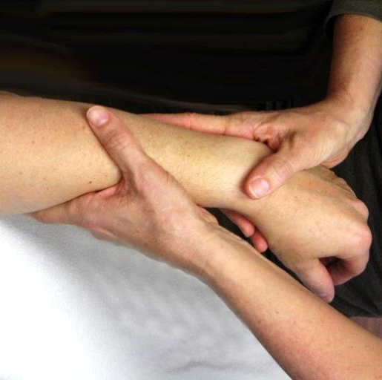
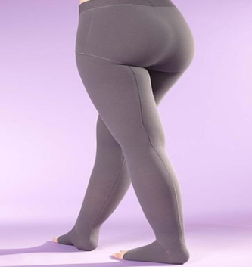
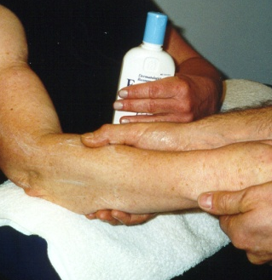
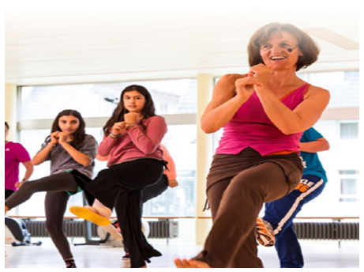
Effective CDT
Notes:
This opening slide depicts the four components of Complete Decongestive Therapy (CDT):
Manual lymph drainage (MLD)
Compression (bandaging and garments)
Skin care
Exercise

Slide 2
Lymphedema is one of the most poorly understood diseases by medical professionals!
Notes:
For a video about patient testimonials see:
Klosetraining.com/klose-videos

Slide 3
The physical, emotional, psychological, psycho-social, and financial impact on patients with lymphedema is largely underestimated!

Slide 4
4 Challenges in the
Treatment of Lymphedema
1. The chronic and progressive nature of lymphedema.
2. Treatment options for patients with lymphedema.
3. Various stages of lymphedema.
4. Poorly understood by medical professionals.
Notes:
There are many misconceptions about lymphedema and its treatment.
These four challenges in the treatment of lymphedema will be explained in more detail on the following slides.

Slide 5
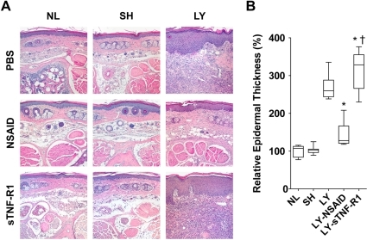

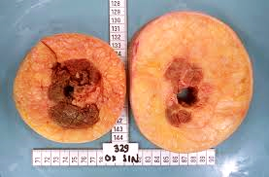
Lymphedema
Lymphatic impairment
Protein-rich fluid Chronic inflammation Fibrosis (connective tissue) Fat deposition More lymphatic impairment Skin changes Infection
Notes:
Note: This slide has many animations. All the components/graphics will be revealed as the presentation is watched as a slide show.
Objective of this slide: To help explain the chronic and progressive nature of lymphedema.
This slide illustrates how the cascade of events associated with lymphedema turns into a vicious cycle even with the best therapeutic intervention.
Lymphedema always starts with lymphatic impairment which then leads to an accumulation of protein-rich fluid and secondary tissue changes. The skin and subdermal tissues become thicker and fibrosis develops. There are varying degrees of adipose tissue accumulation in the affected body part. Adipose tissue deposition in the affected limb will result in additional lymphatic impairment of the affected extremity.
The first set of pictures illustrate a cross section of the epidermis. NL shows normal tissue. In LY, you can see the much thicker subdermal tissue (purple layer). Reference: https://openi.nlm.nih.gov
The second set of pictures shows the cross-section of the upper arms of a cadaver. On the left is the normal arm. On the right, you can see the adipose tissue deposition that has developed in the arm with lymphedema.
Reference: Brorson H. Liposuction in arm lymphedema treatments. Scand J Surg. 2003;92(4):289.

Slide 6
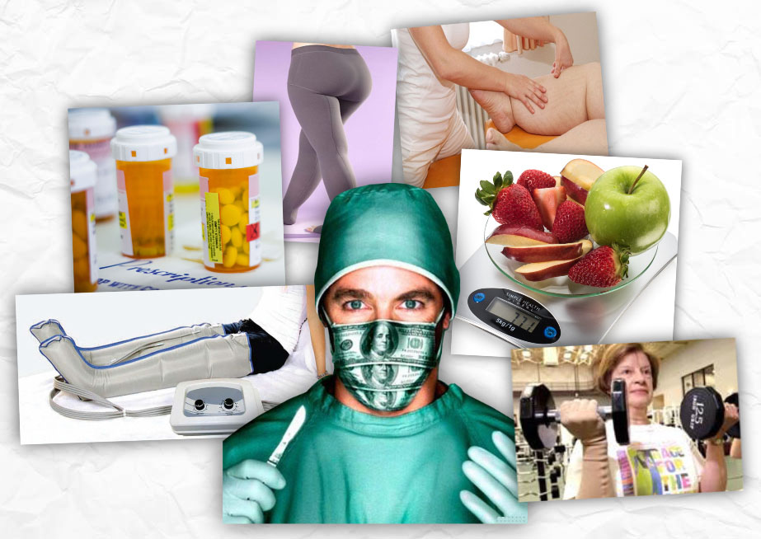
Challenge #2
Notes:
Objective of this slide: To illustrate the many treatment approaches that exist for lymphedema. None offer a cure.
It is difficult for patients to determine which treatment or combination of therapies is correct for them.

Slide 7
Treatment of Lymphedema
NON-SURGICAL
SURGICAL
Physical
Therapy
Drug
Therapy
Psychosocial
Rehabilitation
Resection/Reduction
Procedures
Micro-Surgery
CDT
MLD
Compression
Exercise
Skin Care
Self-Care
Compression garments alone
MLD alone
Intermittent pneumatic pumps
Thermal therapy
Elevation
Low-level laser
Aquatic therapy
Ultrasound
Wringing out “Tuyautage”
Diuretics
Benzopyrones
Antimicrobials/ Antibiotics
Filariasis
Mesotherapy
Immunological Therapy
Diet
Counseling
Support Groups
Liposuction
SAPL
Debulking
Lymphatic (Re)Vascularization
LVA
LLA or LVLA
VLNT
Specialized Surgery
Molecular Therapy
Specialized surgery for complex lymphatic issues
VEGF therapy
ISL Consensus Document 2016
Notes:
This slide, based on the Consensus Document of the International Society of Lymphology (ISL), illustrates the different approaches to lymphedema (surgical and non-surgical).

Slide 8
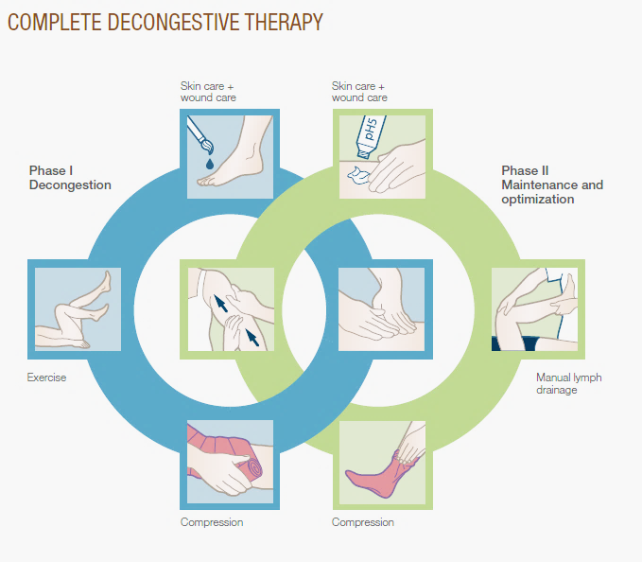
CDT is the standard of care for patients with lymphedema!
Jobst
Notes:
What is complete decongestive therapy (CDT)?
CDT consists of four physical therapy components (skin care, MLD, compression bandaging, and exercise) which – if applied in combination – result in effective treatment for primary and secondary lymphedema. However, effective, long-term management of this incurable condition depends on the interplay of the therapist-based decongestive, “intensive,” phase of therapy and the home-maintenance, “self care,” phase.
CDT is most effective when performed in the manner outlined later in this presentation.

Slide 9
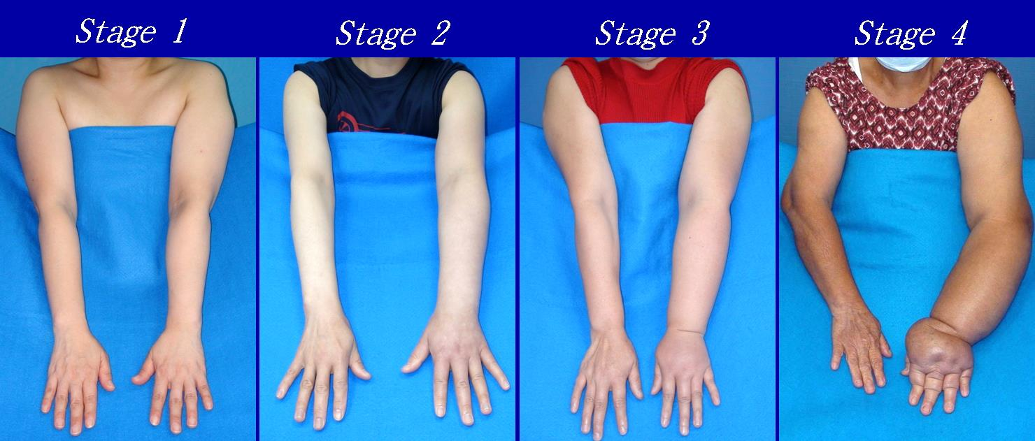
Challenge #3
There is no cookie-cutter approach
to the treatment of lymphedema.
Notes:
Objective of this slide: To illustrate the various stages of lymphedema (UE and LE).
Each patient needs to be treated based on the severity of their lymphedema with consideration of their comorbidities (including obesity!). The patient’s physical and cognitive abilities must also be considered.

Slide 10
What works?
What doesn’t work?
Notes:
With the following slides, let’s take a look at what works and what doesn’t work in lymphedema therapy.

Slide 11
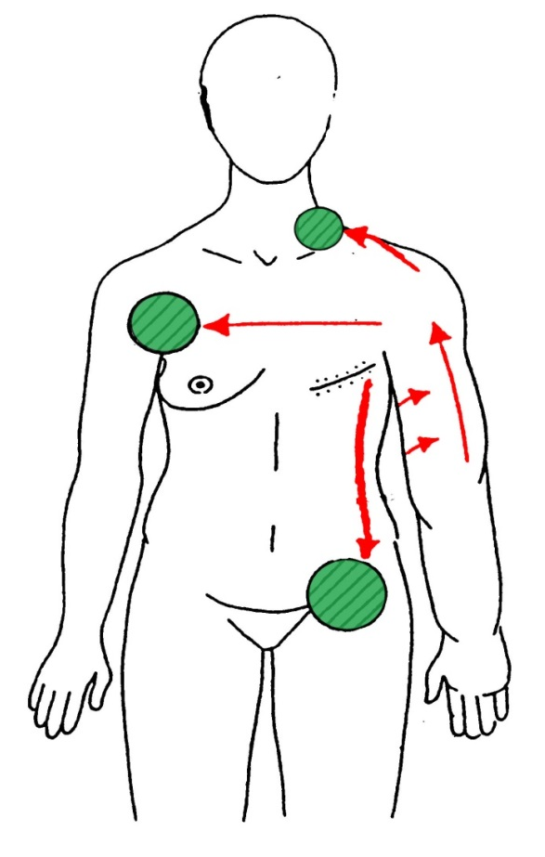
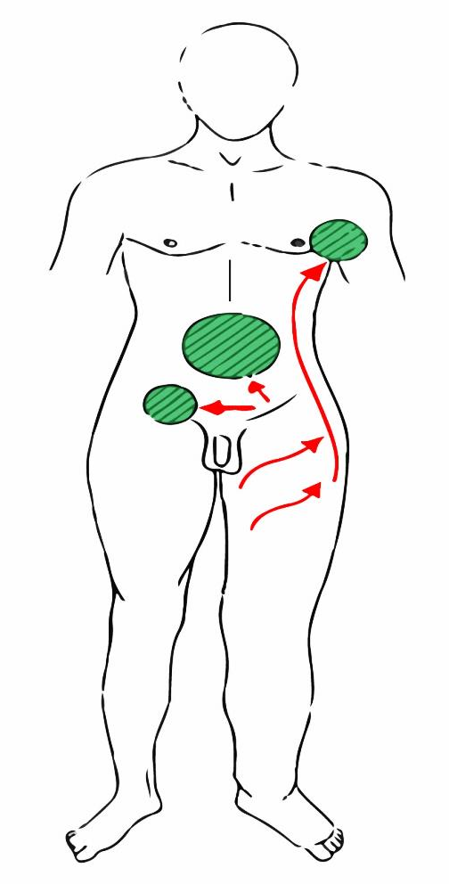
Manual Lymph Drainage (MLD)
Notes:
Manual lymph drainage (MLD) for lymphedema must include the unaffected neighboring quadrants! If these areas are not cleared first, the lymph in the affected area(s) has nowhere to go.

Slide 12
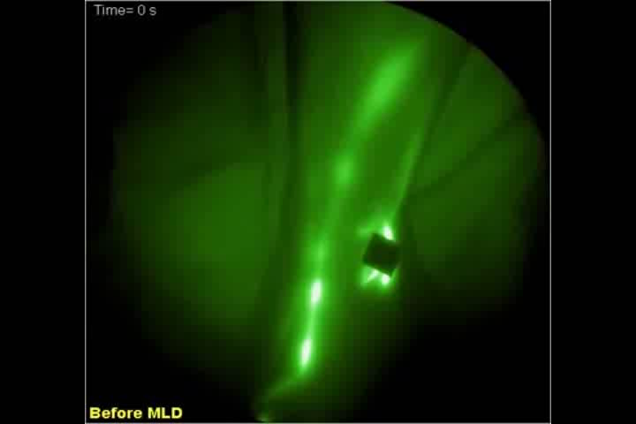
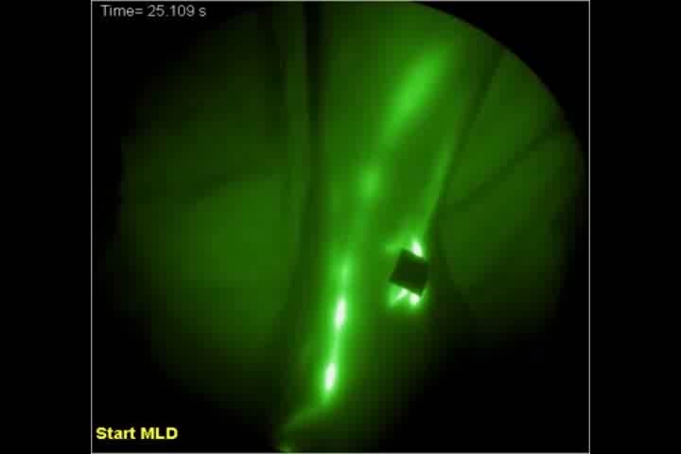
Near-Infrared Fluorescence Imaging
E.M. Sevick-Muraca
Before MLD
During MLD
Notes:
The new indocyanine green imaging method allows us to see the effects of MLD in real time.
Left: Normal transport of lymph fluid through the collector. Note the slow movement through the lymph collectors.
Right: During MLD, you can see the increased lymphatic uptake through the collector.
https://www.youtube.com/watch?v=YmwC0A3PWhM

Slide 13
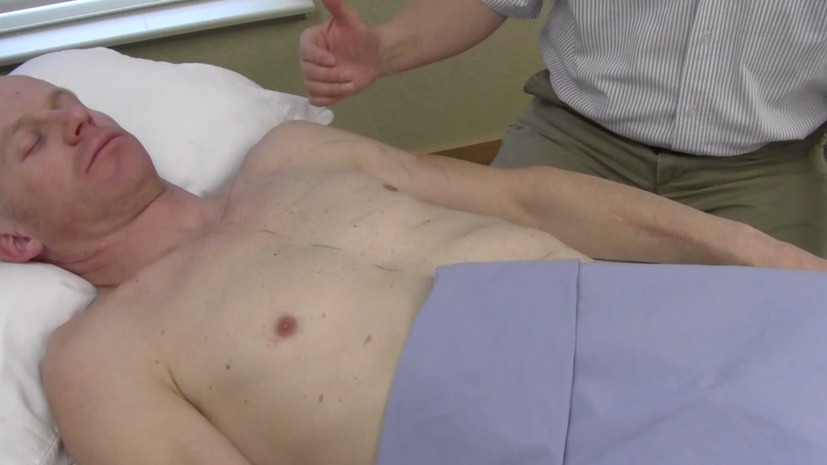
Effective MLD
Notes:
Effective MLD stretches the skin and subdermal tissues! Many therapists are too light with their pressure and don’t stretch the skin/collectors.
Sometimes, deeper pressure is used to treat fibrosis or large lobular edema.

Slide 14
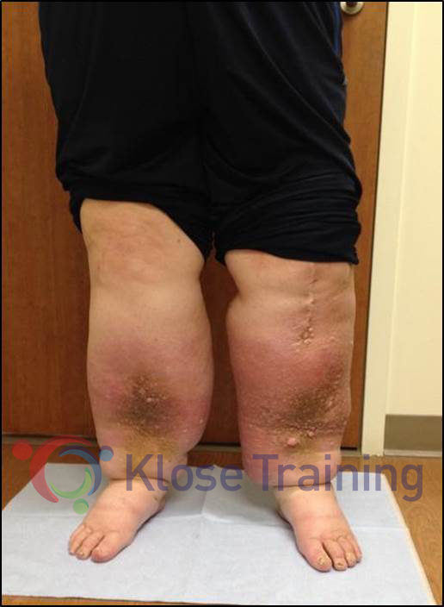
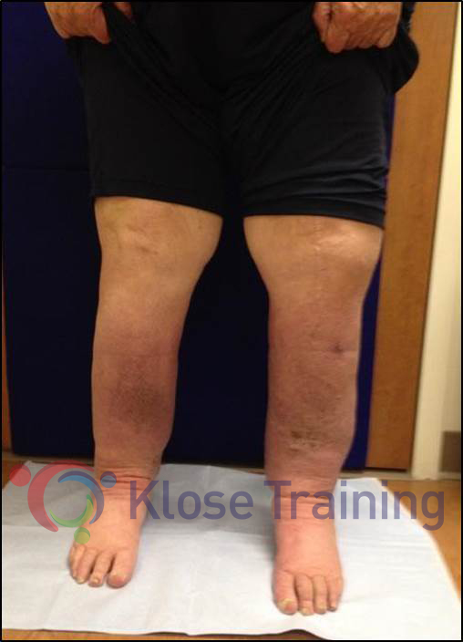
MLD alone does NOT work!
Patient after 10 years
of MLD-only treatments
After 3 weeks of CDT
(4x/week)
Notes:
This patient was treated with MLD (off and on) for 10 years without improvement. In fact, the lymphedema got progressively worse over time, which is the normal progression of lymphedema.
After 3 weeks of CDT provided 4x/week by a skilled Certified Lymphedema Therapist (CDT), the edema was markedly reduced and the health of the skin improved dramatically.
This comparison should convince even the biggest skeptic that CDT is an effective therapy for lymphedema – when administered correctly.

Slide 15

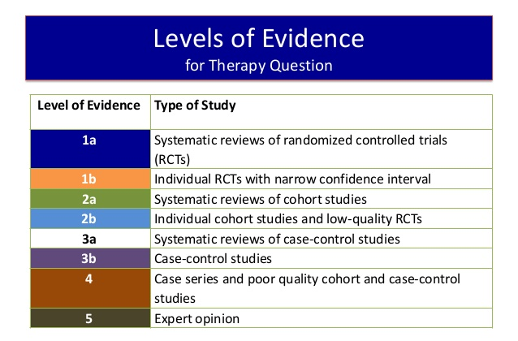

Inadequate MLD
Notes:
Objective of slide: To illustrate that 20 minutes of MLD is inadequate to treat all the areas that need to be addressed.
It would be difficult to conduct a scientific study to try and establish how long an MLD therapy session needs to be in order to be effective; there are too many variables, including the MLD technique and skill of the CLT. However, clinical experience has demonstrated that, because MLD for lymphedema must include the unaffected areas and the affected areas of the body, 20 minutes of MLD is not long enough to be effective!

Slide 16


CDT Treatment Session Time
Notes:
Many facilities have cut the therapy time to 45 minutes per session – this is simply not enough time to address all the components of CDT adequately and provide the patient education needed for the patient to be successful with their self-care after Phase 1 of decongestive therapy. Treatment appointments should be 60 minutes minimum!

Slide 17

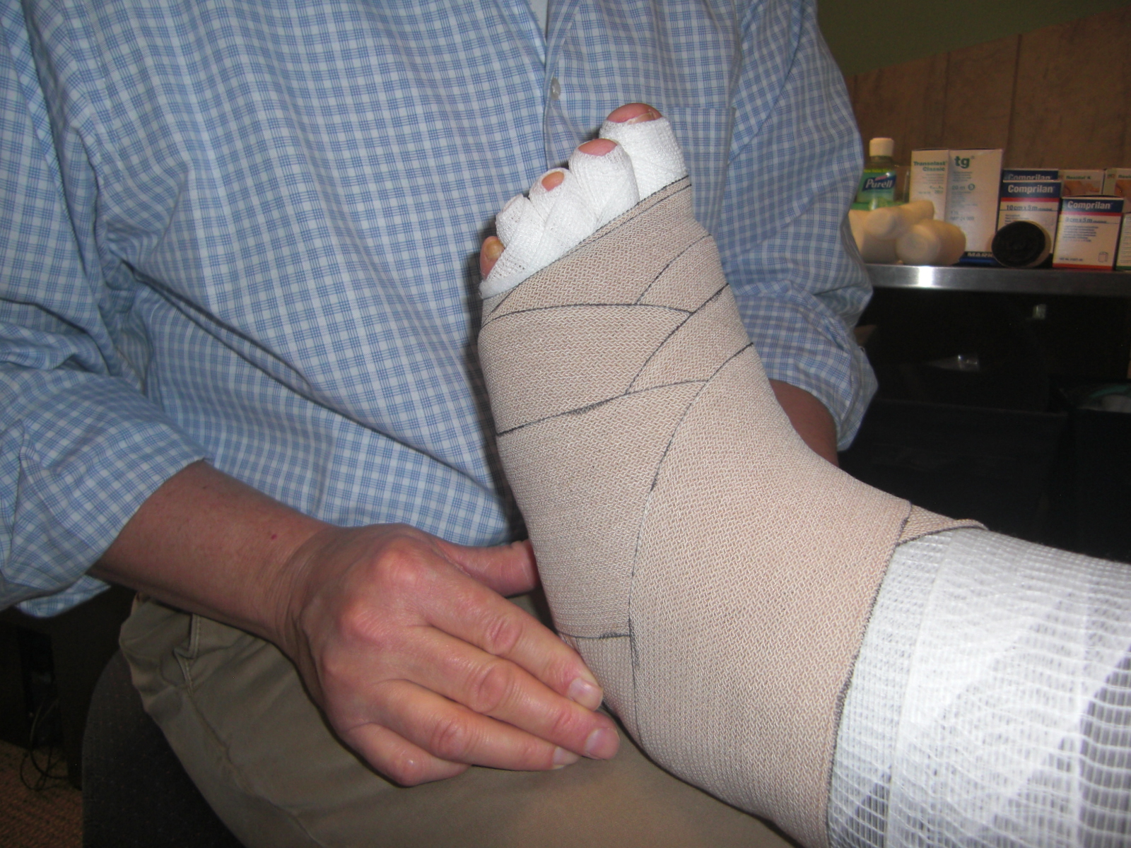
Pumps and Bandaging
Notes:
Compression pumps are sometimes necessary to support patients in their self-care (Phase 2 of CDT), especially for those patients who are unable to visit their therapist on a regular basis. However, pumps should not be used in a clinical setting as a replacement for manual therapy (MLD).
Nor should bandaging be the only treatment. Bandaging alone is not the correct treatment for lymphedema!

Slide 18
Two-Phase Treatment of Lymphedema
The Intensive (Decongestive) Phase leads
to the Self-Care Phase!
Intensive Phase
Daily treatments
MLD
Compression bandaging
Remedial exercises
Skin & nail care
Instructions in self-care
Number of treatments depends on severity
Self-Care Phase
Garments (daytime)
Bandaging (night)
Exercises (daily)
Skin & nail care
MLD as needed
Follow-up visits
© Klose Training 2018
Notes:
CDT is very well described in the literature. The Foeldi Textbook of Lymphology describes treatment application this way:
“During Phase 1 of CDT, the patient must be treated at least once a day. If treatment cannot be given on Sunday, the patient must wear the bandages from Saturday until Monday. Attempts to apply CDT once or twice a week are doomed to failure.”
Putting this statement in perspective, it is not advisable to treat patients with CDT seven days/week. CDT is a demanding treatment and patients will benefit from a one or two-day break after receiving five treatment sessions. However, in order to be effective, the patient must continue to wear their compression bandages when not in treatment.

Slide 19

Notes:
Limitations in healthcare are blamed for the reduction in therapy time devoted to CDT. However, a comparison between a private lymphedema clinic and a hospital-based lymphedema program shows that the overall number of treatment visits is fewer when the patient is first seen on a daily basis. The private clinic provided lymphedema therapy 5x/week, Monday – Friday, for 2 weeks, then less frequently during the 3rd and 4th weeks. In the hospital program, patients were treated only 2x/week. This informal comparison was conducted by Linda M. Hodgkins, MS, OTR/L, CLT-LANA. (See the following slide.)

Slide 20

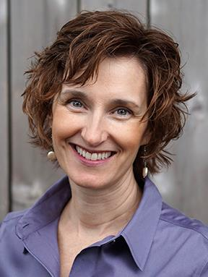
 | Lymphedema Clinic | Hospital
Number of visits per week | 5 | 2
Average total number of visits | 13 | 17
Overall reduction and adherence | +++ | +
Notes:
This chart compares the number of treatment visits and the quality of outcome at a private lymphedema clinic and a hospital-based program.
The hospital subsequently converted to treating patients 5x/week with a decrease in frequency in the 3rd and 4th week.

Slide 21
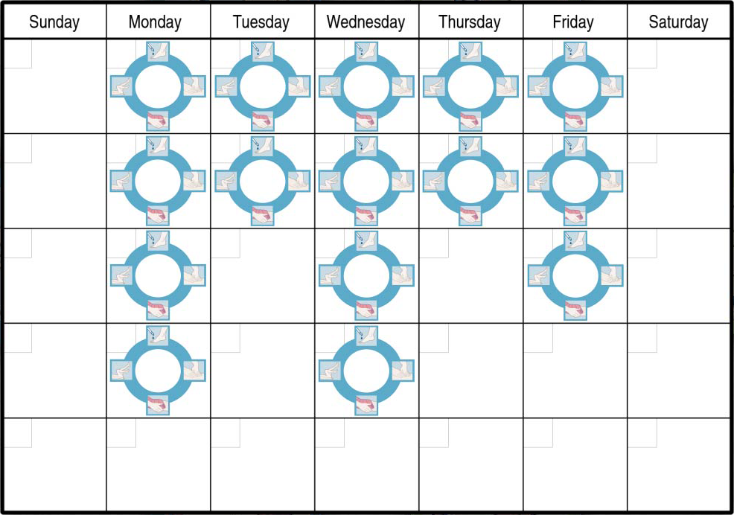
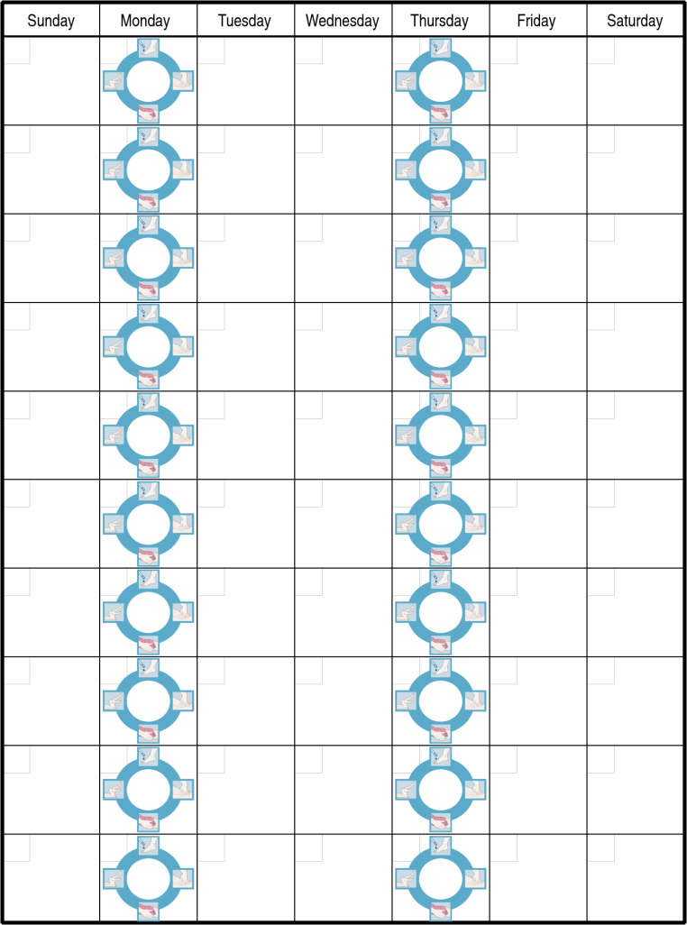
Treatment Schedules
Most effective schedule for treatment
Noneffective
treatment schedule
Notes:
To reiterate, the most effective schedule for treating lymphedema is daily (weekdays) for two weeks, then reduced frequency for the next two weeks. It is critical that the patient wear their compression bandages when not in treatment.

Slide 22
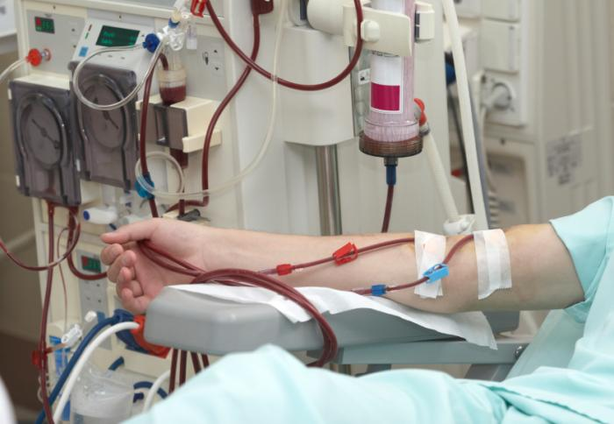
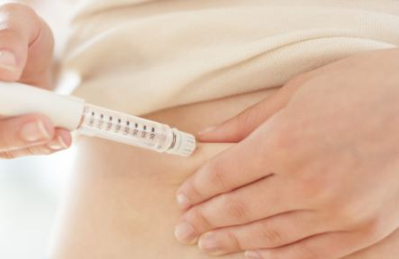
So, what about:
My patients don’t want to come 5x/week; it’s not practical for them.
My patients don’t want to be bandaged.
My patients can’t afford ____.
Notes:
Suggested responses to the listed questions:
Practicality: If the therapist clearly explains to patients that their treatment will be faster, more effective, and less expensive if they are seen daily, that is often enough for the patient to make the sacrifices necessary to commit to daily treatments 5x/week. The patient must be made aware that lymphedema can be life threatening due to the risk of infection. Indeed, many chronic diseases call for frequent treatments, e.g. dialysis for those with kidney failure. While these treatments may not be convenient, few would argue that they’re “not practical,” nor would short cuts be made.
Aversion to bandaging: It must be made clear to the patient that MLD alone is not the treatment for lymphedema. If a patients is unwilling to receive the bandaging, perhaps treatment should be delayed until the patients is ready to receive the full treatment.
Affordability: Never make assumptions about a patient’s ability to afford treatment supplies, incl. custom garments. They may have personal sources of financial support. If not, explore funding through cancer support groups and organizations, hospital funds for indigent patients, or fundraising websites such as Go Fund Me.

Slide 23
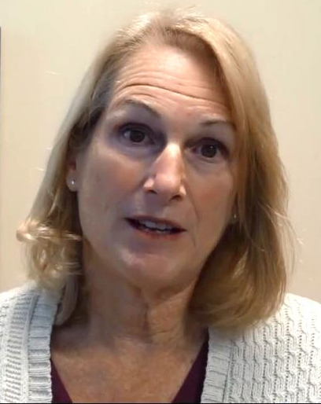
Patient Testimonial
For a video testimonial on how proper lymphedema therapy changed a patient’s condition after many failed attempts to receive proper lymphedema therapy, watch:
Michele’s Story: Finding Effective CDT
klosetraining.com/resources/klose-videos

Slide 24
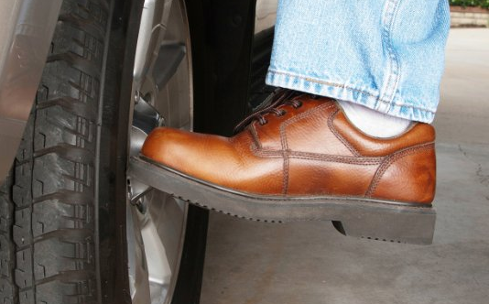
Patients need to check the credentials and experience of the therapist!
What is included in their lymphedema program?
Notes:
Patients need to “kick the tire” to check the qualifications of a therapist. Here are questions that patients should ask before they choose a therapist, along with information to help interpret the answers.
Q: Is the therapist certified as a lymphedema therapist (CLT)? If so, what was the length of their training?
A: The Lymphology Association of North America (LANA) recommends a program of at least 135hrs, 2/3rds of which should be devoted to hands-on training under the guidance of a qualified instructor.
Q: Is the therapist LANA-Certified?
A: While there are many excellent therapists who are not LANA-Certified, and conversely, there are some LANA-Certified CLTs who are not of the highest caliber, the LANA exam does assure that the therapist has the requisite knowledge for treating lymphedema. Also, LANA-certified therapists must complete continuing education in lymphology in order to maintain their certification.
Q: How long have you been treating lymphedema?
A: While you might get excellent care from a recent graduate of a lymphedema treatment certification program, as with any profession, experience often makes for a better professional – but only if the therapist practices correct methodology.
Q: What percentage of your work is devoted to treating patients who have lymphedema?
A: The majority. (As with any profession, the more practice you have, the better you are likely to be.)
Q: What does treatment involve?
A: The answer should be: Complete Decongestive Therapy (CDT) which includes manual lymph drainage (MLD), compression therapy, skin care, exercises, and instructions in self care.
Q: What treatment frequency is recommended for a patient who has never received treatment for their lymphedema?
A: Treatments should be daily (5x/week) until the limb is adequately decongested and the patient has received their daytime/nighttime garment, as appropriate.
Q: How long are the treatment appointments?
A: 60 minutes should be the minimum appointment time in order for the therapist to provide effective treatment and self-care education for the patient.
Q: Does the clinic/therapist use a compression pump in lieu of hands-on MLD?
A: Pumps should not be used by a therapist instead of MLD. MLD should only be provided hands-on. However, pumps can be helpful as an adjunct therapy for some patients in the self-care phase of the treatment.
Q: Has the therapist had any additional training in [specialty area of lymphedema such as head & neck or genital lymphedema]?
A: Most lymphedema treatment training programs focus on extremity lymphedema. In order to effectively treat lymphedema manifesting in other areas, a therapist may need extra training.

Slide 25

Challenge #4
Lymphedema affects ~3-5 million Americans, more than the following diseases COMBINED, yet ignorance within the medical field is rampant.
Parkinson's (1,000,000)
Multiple sclerosis (400,000)
Muscular dystrophy (250,000)
Cystic fibrosis (30,000)
ALS (30,000)
Notes:
See next slide.

Slide 26
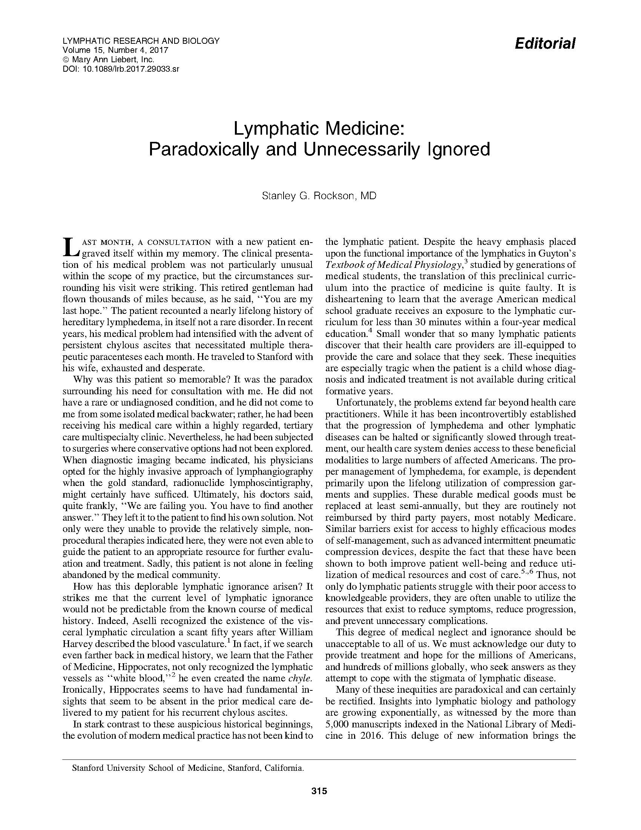

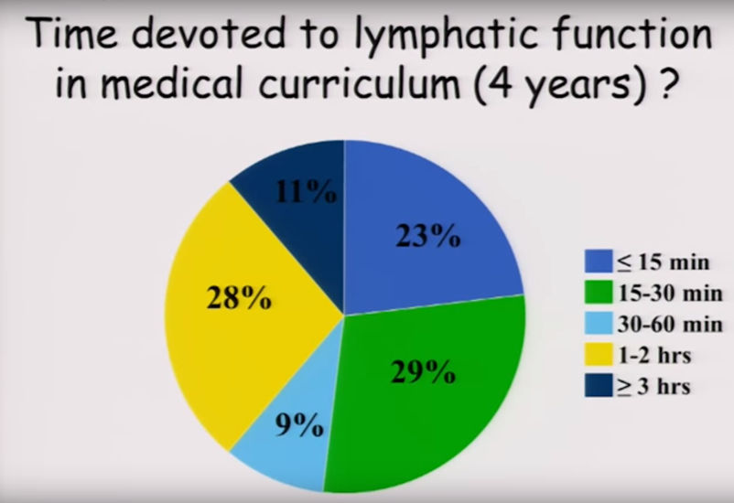
Notes:
Lymphedema is very often misunderstood in the medical community in large part because most medical students receive less than 30 minutes of education on lymphatic function. Because of this, it is common for people with lymphedema to go years without proper diagnosis and treatment. The social and psychological impacts of the condition are also rarely acknowledged.
Read Dr. Stanley Rockson’s editorial, “Lymphatic Medicine: Paradoxically and Unnecessarily Ignored” at: https://www.ncbi.nlm.nih.gov/pmc/articles/PMC5787933/

Slide 27
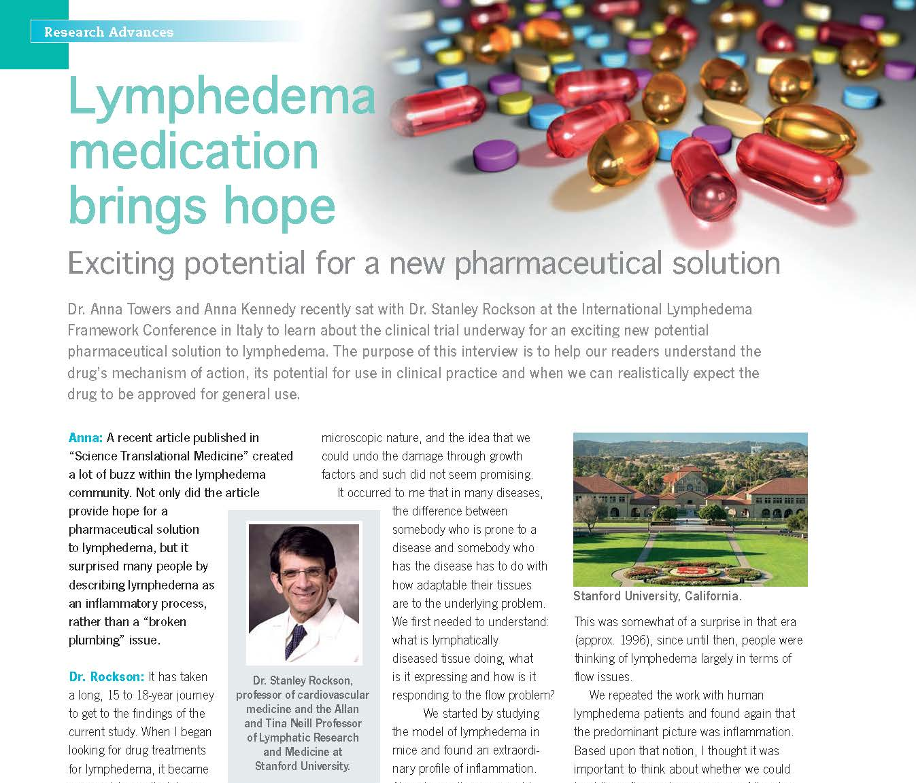
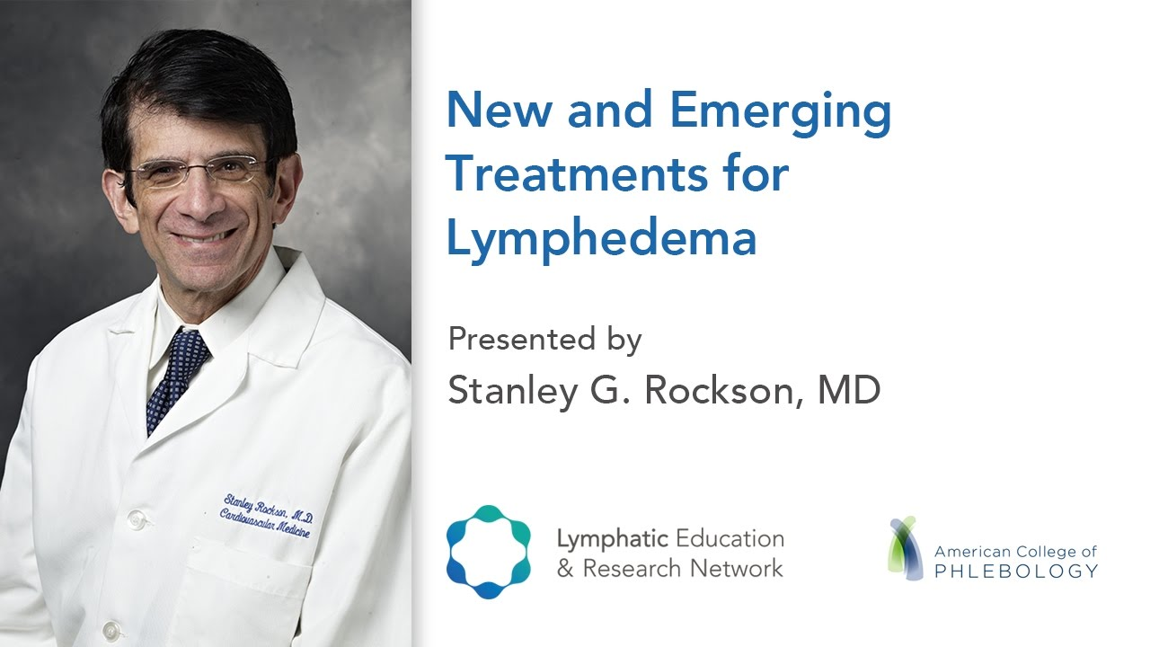
Notes:
A medication that is now being tested for FDA approval may, in the future, provide an additional tool in lymphedema treatment. Watch “New and Emerging Treatments for Lymphedema” with Dr. Stanley G. Rockson: https://lymphaticnetwork.org/symposium-series/new-and-emerging-treatments-for-lymphedema
An interview with Dr. Rockson is also printed in Pathways, Fall 2017. Pathways is a publication of the Canadian Lymphedema Framework. A pdf of an extended version of the interview is available at https://lymphaticnetwork.org/symposium-series/new-and-emerging-treatments-for-lymphedema.

Slide 28

Notes:
There is a general lack of research regarding the effectiveness of CDT because there are too many variables in the treatment of patients with lymphedema. Among other difficulties, phenotyping patients, applying the same consistent manual therapy (the quality of MLD and bandaging varies greatly between practitioners), and the time requirement to provide effective therapy, are obstacles in providing the empirical evidence so desperately needed.
This however, should not be an excuse for healthcare facilities to provide sub-standard lymphedema therapy. Protocols based on clinical successes have long been established by providers such as the Foeldi Clinic in Germany, a renowned treatment facility for people with lymphedema and lipedema.

Slide 29
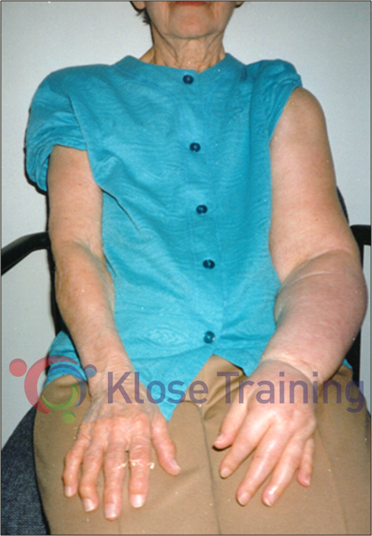
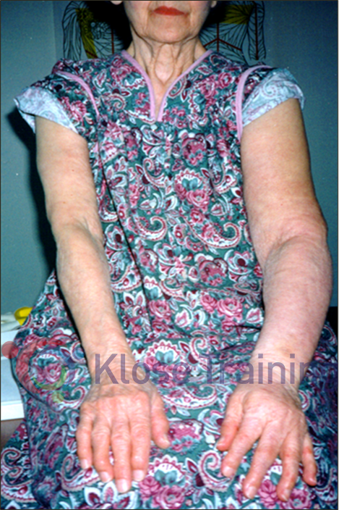
Patient with Secondary UE Lymphedema Before and After CDT
Notes:
Patient with secondary lymphedema and paralysis following breast cancer surgery, before and after 4 weeks of CDT (5x/week).

Slide 30
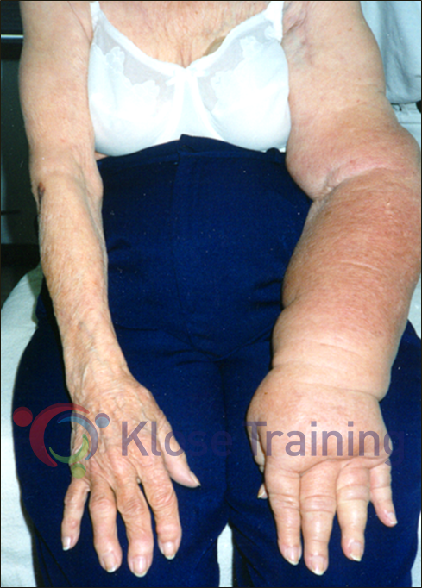
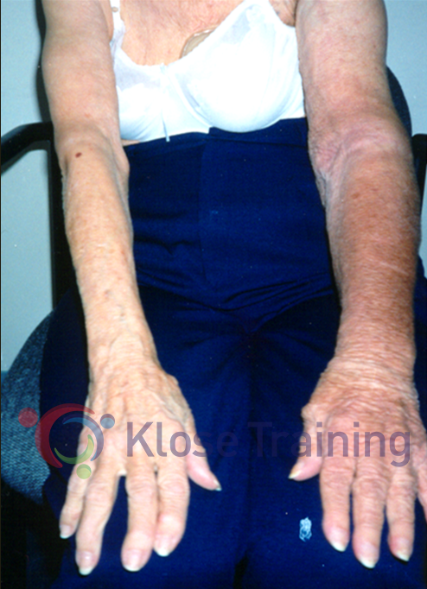
Patient with Secondary UE Lymphedema Before and After CDT
Notes:
Patient with secondary lymphedema following breast cancer surgery, before and after 4 weeks of CDT (5x/week).

Slide 31
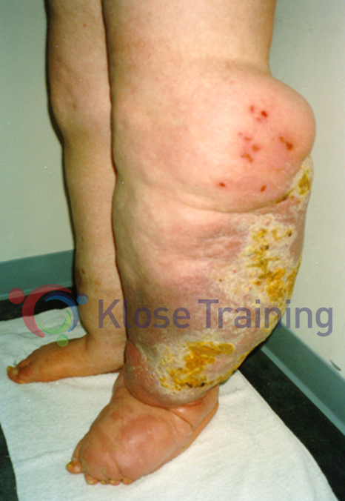
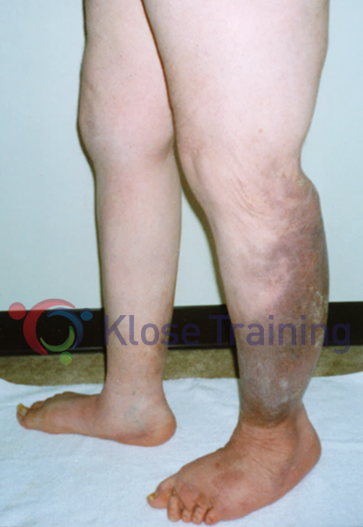
Patient with Primary LE Lymphedema Before and After CDT
Notes:
Patient with primary LE lymphedema and secondary skin changes before and after 49 treatments given over a 3-month period.

Slide 32
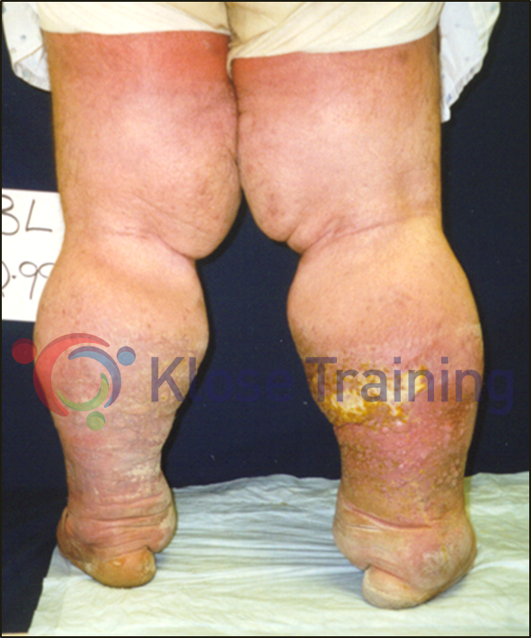
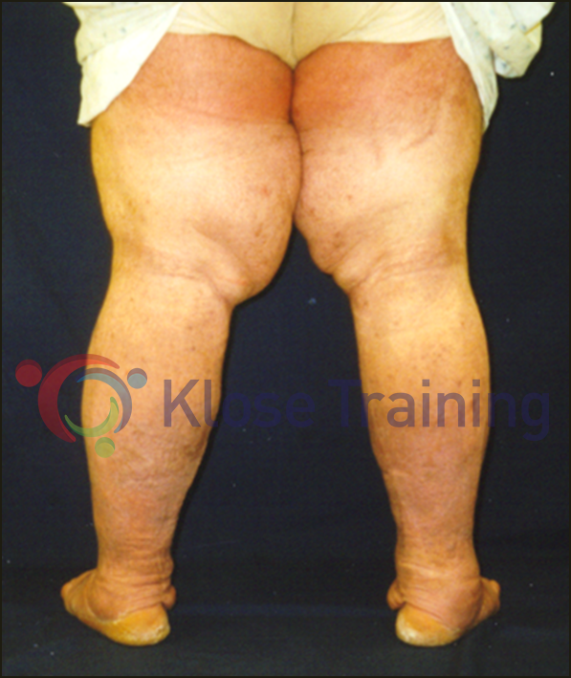
Patient with Secondary LE Lymphedema Before and After CDT
Notes:
Patient with bilateral secondary LE lymphedema after gynecological cancer surgery, before and after 6 weeks of daily CDT (5x/week).

