Slide 1
Lymphedema
Education Session
Presented by:
Kathryn Schmitz, PhD, MPH, FACSM
Perelman School of Medicine
University of Pennsylvania

Slide 2
Questions we will answer:
What is lymphedema?
Who is at risk?
When is it likely to occur?
Why does it happen?
How do I reduce my risk?
How is it treated?
What are the exercise guidelines?

Slide 3
What is lymphedema?
Lymphedema is an abnormal accumulation of protein-rich fluid in the tissue which can result in swelling of a body part and fibrosis.
It only impacts the region of the body affected by lymph node removal/damage.
  Upper body for breast cancer survivors
  Lower body for endometrial cancer survivors

Slide 4
Who is at risk?
Removal of lymph nodes
Damage to the lymph system
Other factors
  Obesity
  Poor diet

Slide 5
How is lymphedema acquired and how rapidly?
Once lymphatics are removed or damaged, lymphedema may occur at any time.
Occurs most often within 3 years of breast cancer treatment.
Lymphedema usually occurs slowly and steadily.
Notes:
Once lymphatics are damaged, lymphedema may occur at any time. Sometimes it starts immediately after lymph nodes or vessels are damaged, sometimes it starts up to 30 years after lymph node dissection, sometimes a very trivial thing may set it off such as a bee sting, sunburn, pet scratch, carrying heavy items, after travel by air.
Why? Fibroblasts become activated in high-protein swelling. This means they start producing new connective tissue. This is the same process in wound healing - to create fibrosclerotic tissue or hard tissue like scar tissue.

Slide 6
Secondary Arm Lymphedema Incidence & Prevalence
Among 1151 women followed for 15 years…
www.nci.nih.gov - lymphedema

Slide 7
What does the lymphatic system do?
Provides surveillance against cancer/infection
Balances fluid and proteins in the circulatory system by transporting several liters of lymph fluid per day
Assists fat digestion
Notes:
The lymphatic system is a network of vessels and nodes which transports and filters lymph fluid thereby performing a surveillance and detection of invading cells. Immune fighting cells are orchestrated to prevent illness.
The lymphatic system transports approximately 2 liters of fluid per day thereby balancing fluids and proteins in the circulatory system.

Slide 8
Role of the Lymphatic System
Transports proteins
Removes excess water
Absorbs fat molecules from the gut
Removes cellular debris and foreign material (e.g. bacteria, viruses, cancer cells)
Notes:
The main function of lymphatic system is to transport proteins. The arrival of proteins to lymph nodes triggers further defense mechanisms.
Excess water is removed via the vein of the lymph node.
Excess fat molecules meaning triglyceries or long chain fatty acids are too big to enter the blood capillaries and must be transported by the lymph vessels.
Cellular debris such as dead cells after an acute inflammation, and non cellular substances such as dust particles, tatoo ink, asbestos are transported by the lymphatic system.

Slide 9
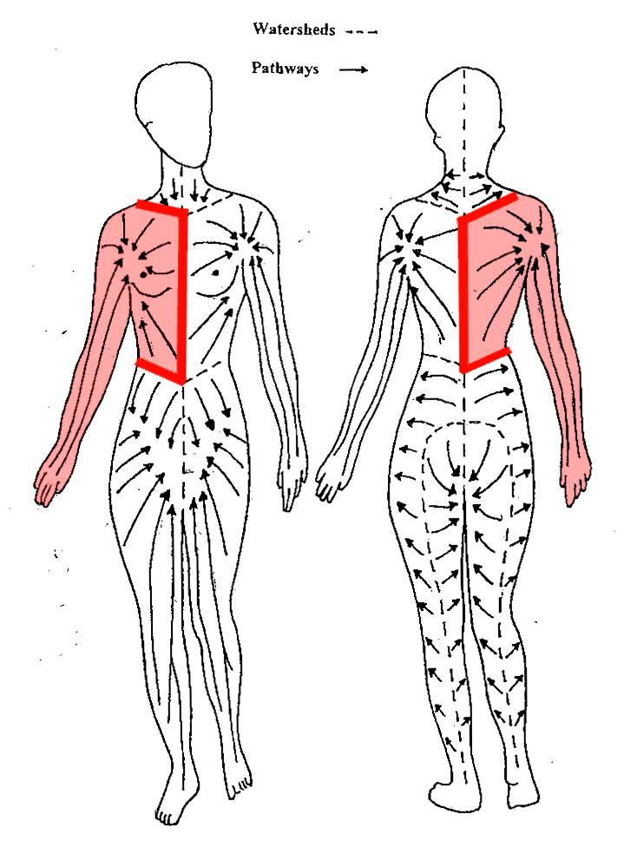
Skin Lymph Drainage Territories
The at risk region is the area where lymph nodes were removed. This includes all tissues in the arm, chest and back that are draining lymph fluid toward those nodes.
Notes:
The lymphatic system is part of the blood system but circulates differently. The lymphatics drain specific body parts as designated in this diagram of the superficial or skin drainage lymph territories. This occurs by the lymph vessels having valves in the deeper collectors which are a one-way transport system.

Slide 10
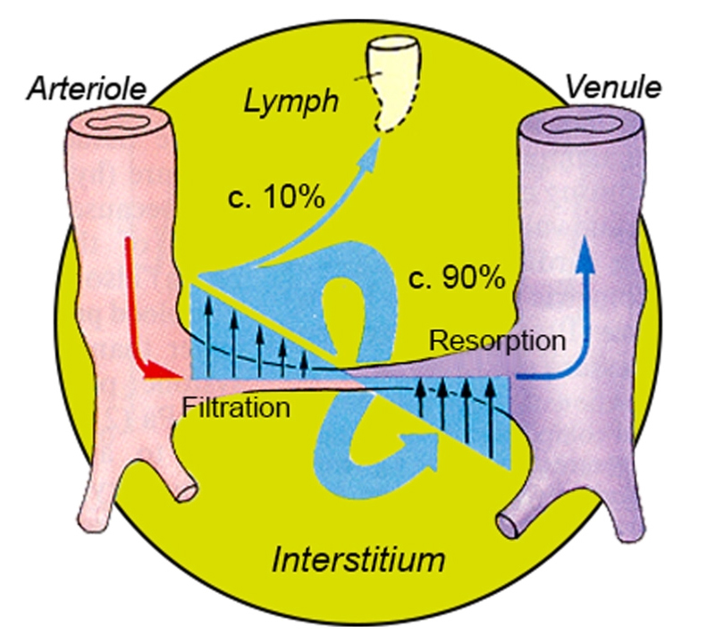
Illustrating the Concept of Lymph Formation

Slide 11
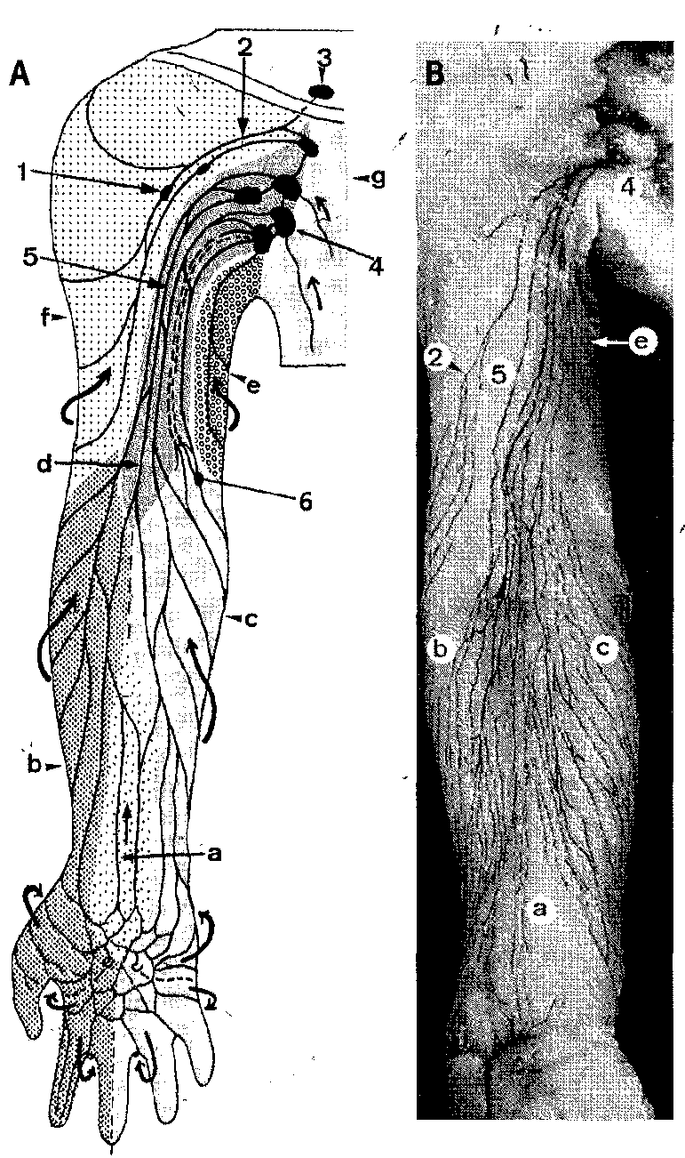
Arm Lymph
Drainage

Slide 12
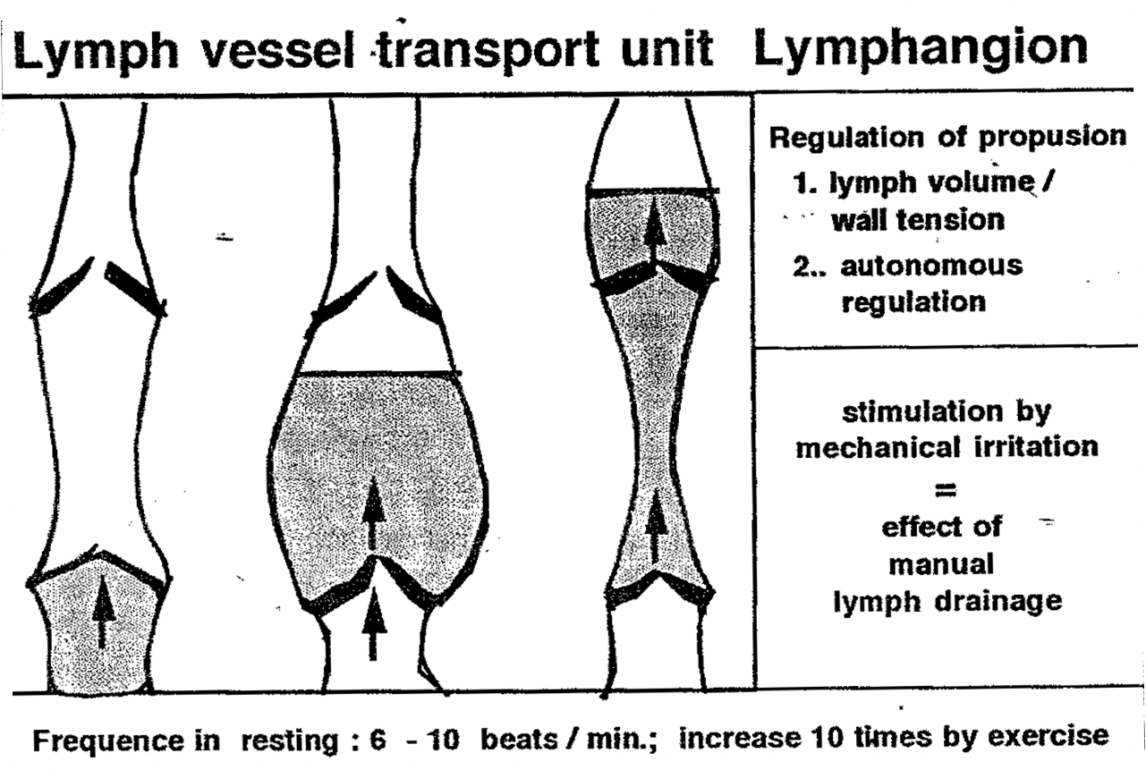
Lymphangion
Notes:
When the wall of the lymphangion is stretched, it creates a pulse. If more lymph is produced, the stretching and filling increases, thereby increasing the impulses of lymph flow.

Slide 13
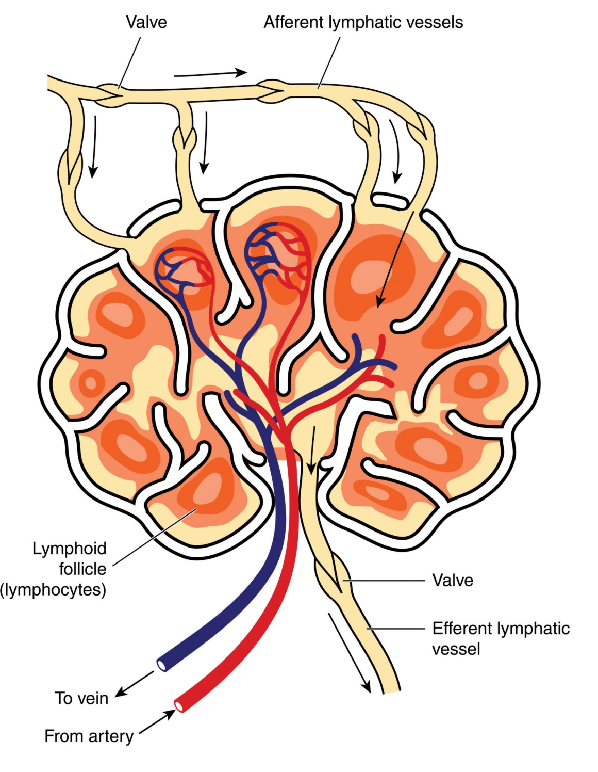
Lymph Node

Slide 14
Thoracic Duct

Slide 15
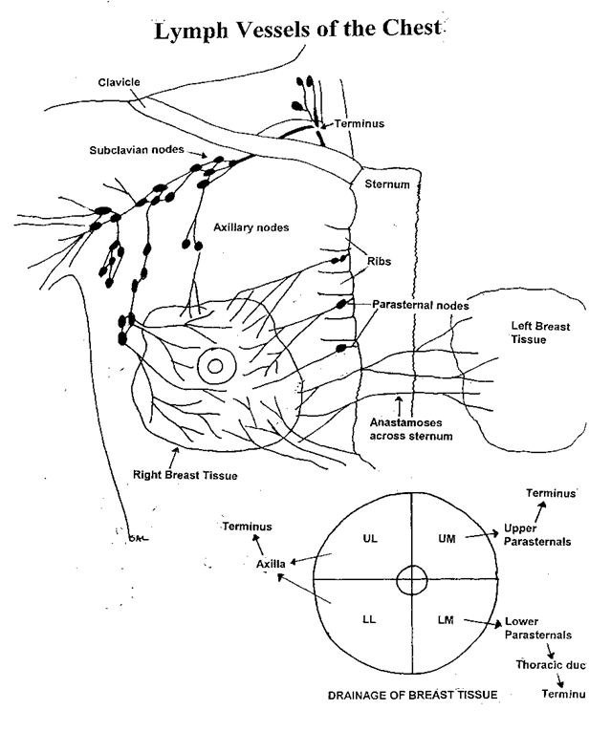
Breast Lymph Drainage

Slide 16
Lymph Drainage System
Filtration
(Arteries)
Lungs
Heart
Starling’s Equilibrium
Lymph System
(Lymph Obligatory Load)
Resorption
(Veins)
Notes:
This is a schematic of lymph circulation. The faucet represents the arteries, pouring fluid out from the heart into the tissues at the capillary bed. The main drain is like the vein system, draining most of the water. When these two forces are balanced, no overflow occurs. If a disturbance was to occur in the main drain, the tub would fill but the overflow drain acts like the lymph system, able to handle the excess water load thereby preventing the tub from overflowing. This is called Starlings equilibrium.

Slide 17
Stages of Lymphedema
Stage 0 − Latent, sub-clinical
Stage 1 − Spontaneously reversible
  At this stage, it is present during the day but goes away overnight
  Pitting starts between Stage 1 and 2
Stage 2 − Spontaneously irreversible
  By this stage, it is still present after a night’s rest, even if improved
Stage 3 − Lymphostatic Elephantiasis
  Rare occurrence in breast cancer

Slide 18
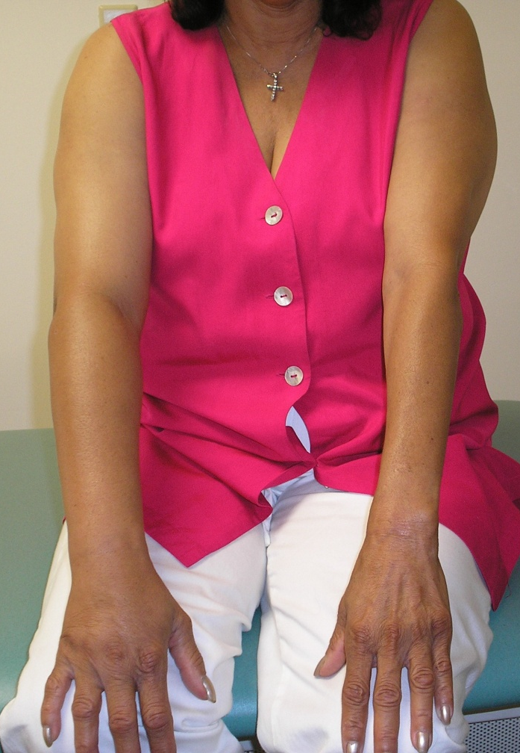
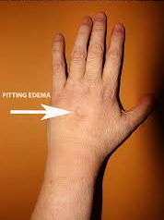
Breast Cancer-Related Lymphedema

Slide 19
What changes occur with an altered lymph system?
Excess protein in the tissues
Accumulation of excess fluid in the limb
Decreased oxygenation
Slow tissue-healing time
Formation of fibrosis

Slide 20
What does lymphedema feel like?
Tightness or heaviness in the limb
Achy
Pins and needles
Tenderness in the elbow
‘Odd’ sensations
‟Pain of congestion”
Discomfort
NOT ‟unbearable pain,” which might be
  malignant lymphedema
  radiogenic plexopathy
NOT muscle soreness
  Let’s discuss the difference…

Slide 21
National Lymphedema Network (NLN) materials associated with this education session
Training of therapists
Risk-reduction guidelines
Treatment of lymphedema
Exercise guidance

Slide 22
How can you reduce your risk of developing/worsening lymphedema?
Lymphedema risk-reduction practices include:
  Skin care
  Activity and lifestyle
  Avoiding limb constriction
  Compression garments (If appropriate)
  Avoiding extremes of temperature

Slide 23
Skin Care
Avoid trauma/injury and reduce infection risk
  Keep arm clean and dry
  Apply moisturizer daily to prevent chapping and chafing of skin
  Give attention to nail care; do NOT cut cuticles
  Protect exposed skin with sunscreen and insect repellent
  Use care with razors to avoid nicks and skin irritation (shave arm pit/axilla with electric razor)
  Wear gloves while doing activities that may cause skin injury
  If scratches/punctures to skin occur, wash with soap and water, apply antibiotics, and observe for signs of infection
  If a rash, itching, redness, pain, increased skin temperature and swelling, fever, or flu-like symptoms occur, contact your physician immediately

Slide 24
Activity and Lifestyle
Gradually build up the duration and intensity of any activity or exercise
Take frequent rest periods during activity to allow for arm recovery
Monitor the limb during and after activity for any change in size, shape, tissue, texture, soreness, heaviness, or firmness
Maintain a healthy weight

Slide 25
Avoid Limb Constriction
If possible, never have your blood pressure taken on the arm at risk
Wear loose-fitting clothing and jewelry

Slide 26
Compression Garments
Should be well-fitting
Support the affected limb during strenuous activity (e.g. weight lifting!)
If you have lymphedema, wear a well- fitting compression garment for air travel

Slide 27
Extremes of Temperature
Avoid exposure to extreme cold - which can be associated with rebound swelling - or chapping of skin
Avoid prolonged (>15 minutes) exposure to heat, particularly hot tubs and saunas
Avoid immersing limb in water temperatures above 102 degrees

Slide 28
What can you do if you develop lymphedema?
Get evaluated by your doctor or a Certified Lymphedema Therapist (CLT).
Early treatment results in faster response to treatment, thereby decreasing the length of therapy.
Notes:
An accurate diagnosis of lymphedema is essential for appropriate therapy. In most clients, the diagnosis of lymphedema can be readily determined from the clinical history and physical exam.
In other clients, confounding conditions such as morbid obesity, venous insufficiency, trauma, and repeated infection, hypertension, congestive heart failure, or cerebrovascular disease may complicate the clinical picture.
Lymphedema may be simple or complex but should not be neglected. Accurate diagnosis and effective therapy is available and lymphology itself is now recognized as an important specialty in which clinicians are carefully trained in the intricacies of the lymphatic system, and safe effective therapy.

Slide 29
Training of
Lymphedema Therapists
See handout from the NLN (lymphnet.org). Be sure your therapist meets their minimum requirements.

Slide 30
How is lymphedema treated?
Complete Decongestive Therapy is an effective therapy for lymphedema and other swelling disorders.

Slide 31
Complete Decongestive Therapy
Volume of Extremity
Plateau of Decongestion
Weeks
CDT phase 1
CDT phase 2

Slide 32
Complete Decongestive Therapy
PHASE 1: Decongestion | PHASE 2: Maintenance
Meticulous skin care Manual Lymph Drainage Gradient compression bandaging Remedial exercises Compression garment | Meticulous skin care Day: Compression garment Night: Gradient compression bandaging Self-Manual Lymph Drainage Remedial exercises Follow-up assessment

Slide 33
Meticulous Skin & Nail Care
Low-pH, gentle soaps
Moisturizer (Low pH also recommended)
Do not cut cuticles
Prevent infection
Keep skin working optimally

Slide 34
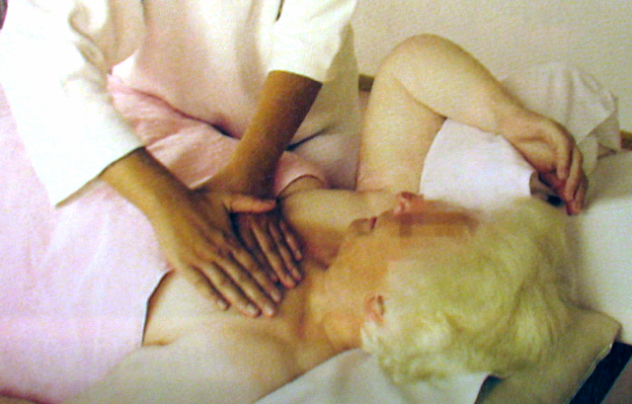
Manual Lymph Drainage
Expert Stretching of the Skin

Slide 35
Manual Lymph Drainage
Drains the congested areas
Reduces the risk of infection
Normalizes the size and pressure in the limb
Reduces pain/discomfort

Slide 36
Compression Therapy
Gradient, short-stretch bandaging
Medical compression garment
Notes:
Compression therapy for lymphedema comes in two forms
Gradient short-stretch bandaging and
Gradient medical compression sleeve
Both are an essential part of Combined Decongestive Therapy.
During phase I, compression bandages are worn exclusively, up to 23 hours, except when showering. Only with compression bandaging can a reduction in the arm volume be achieved. The bandaging technique is provided by the therapist during this phase and is taught to the client for preparation to phase 2.

Slide 37
Gradient Compression Bandaging
Decreases the filtration rate
Prevents re-accumulation of fluid
Softens fibrosis
Provides external counter-pressure during exercise
Notes:
When the skin is compressed with gradient pressure bandaging, fluid is directed to drain through working lymph vessels and nodes more efficiently. This happens because the elasticity of the skin is reduced by the pressure force of the bandages, reducing the amount of fluid accumulating in the tissues and increasing the amount of fluid draining away from the tissue.
With bandaging, hardened tissue or fibrosis, can be softened over time thereby improving the efficiency of lymphatic drainage of the skin
When bandages are worn during exercise, the counter pressure works in concert with the pumping action of muscles. This force helps this muscular pump to aid in draining lymphedema from the limb.

Slide 38
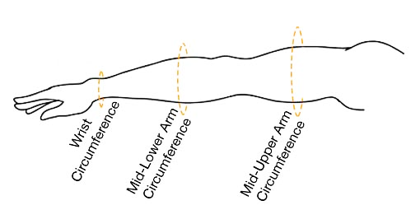
Garment Measurement
Jobst

Slide 39
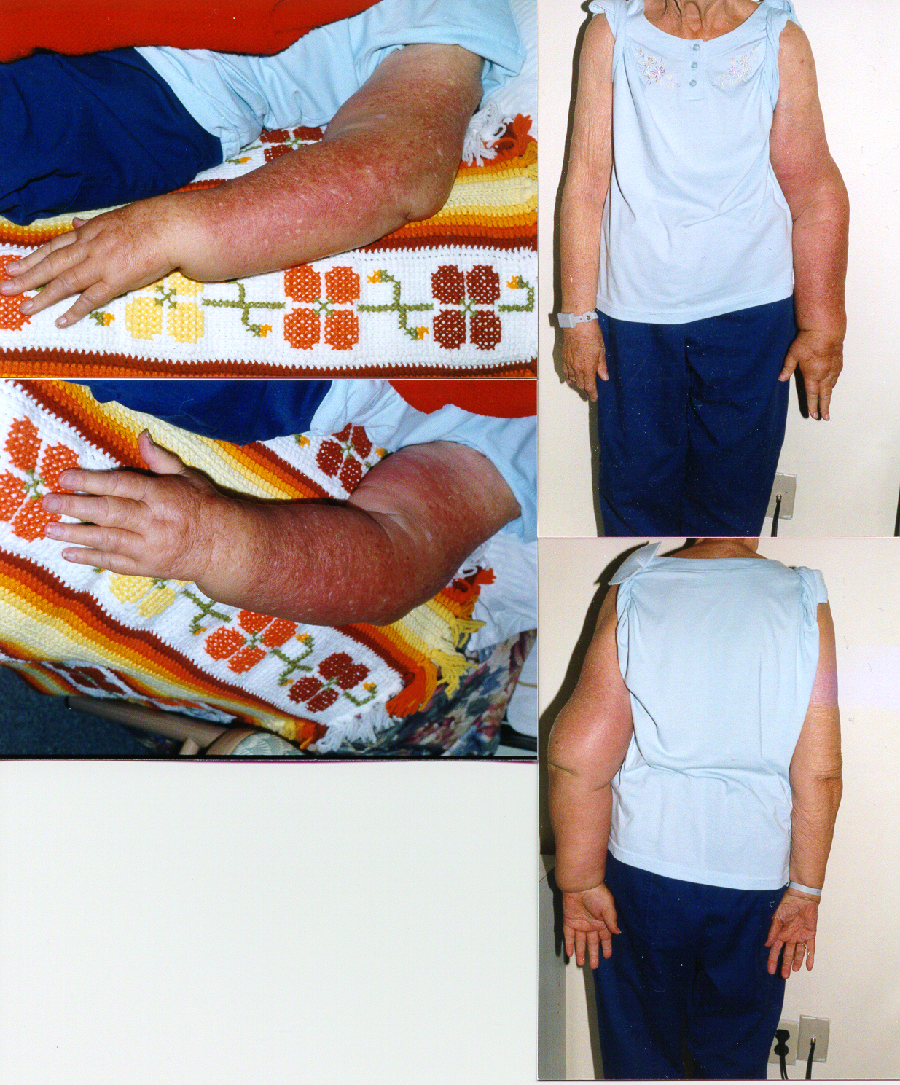
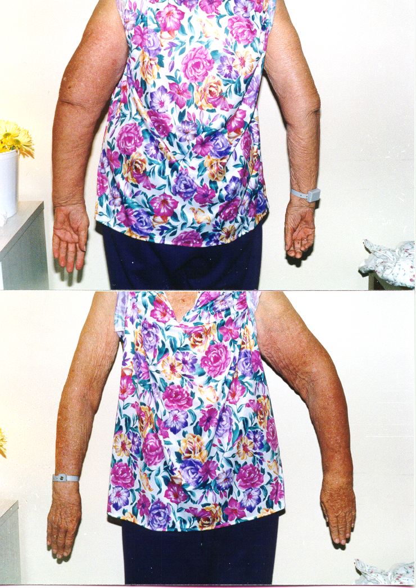
Treatment with CDT
Before CDT
After CDT

Slide 40
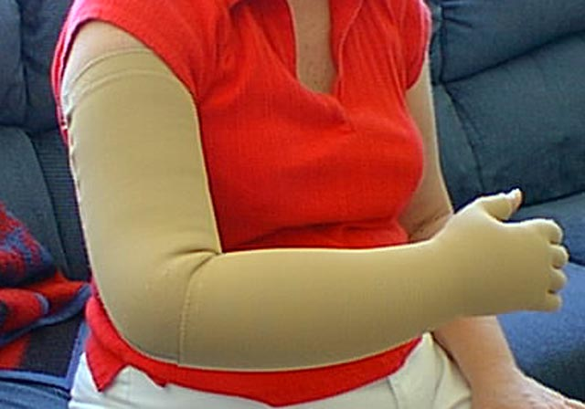
Custom Compression Garment
Notes:
Compression raises tissue pressure thereby having a positive effect when starlings equilibrium is disturbed because it reduces the volume of fluid being filtered into the tissue.

Slide 41
Remedial Lymphedema Exercises
Improves range of motion, endurance, coordination, and strength, where possible. Will provide optimal results with decongestive therapy.
Non-aerobic, gentle stretching
Swimming, scuba diving, singing, yoga, Tai Chi, Chi Kung

Slide 42
Diaphragmatic Breathing
Abdominal breathing stimulates the transport of lymph back to the heart through the thoracic duct.
Notes:
Use deep breathing as often as possible if you have lymphedema

Slide 43
NLN Exercise Guidelines
  GENERAL
  Increase gradually, progress slowly, monitor your limb
  If you have lymphedema, wear a compression garment while exercising
  There is no agreement on whether you should wear a garment if you do NOT have lymphedema
  Modify your program according to your symptom response
  Stay well hydrated
  Avoid getting overheated
  Lymphedema Exercises
  Non-resistive active motion of the affected arm
  Part of treatment and risk reduction

Slide 44
NLN Exercise Guidelines (cont.)
Flexibility/Stretching
  May improve lymph flow by decreasing scarring and tightness
  Avoid over-stretching
Strength Training
  Modifications are needed
  Adequate rest between sessions is crucial
  Modify your program according to your symptom response

Slide 45
NLN Exercise Guidelines (cont.)
Aerobic conditioning
  Thought to be beneficial for individuals with lymphedema
  Deep respiration enhances lymph drainage
  Avoid injury by increasing very gradually
  Avoid getting overheated
  Modify your program according to your symptom response

Slide 46
NCCN/ACS/ACSM Guidelines for Breast Cancer Survivors
Avoid inactivity
Build to 150 minutes/week of aerobic activity
Daily flexibility activities are encouraged
Strength training activities are safe
  Start with a SUPERVISED program
  Start low, progress slow
  If you have any change in upper-body symptoms that last a week or longer, get an evaluation by a clinician
  Careful with overall arm work (e.g. If you garden on a Monday, wait to do strength training ‘till Tuesday)
  Back off resistance after an exercise holiday

Slide 47

Strength After Breast Cancer
Based on a large clinical trial conducted at U. of Pennsylvania
  154 survivors WITHOUT lymphedema
  141 survivors WITH lymphedema
Women who participated had these benefits:
  50% reduced likelihood of lymphedema worsening
  70% reduced likelihood of lymphedema onset among women with 5 or more nodes removed
  Improved strength and energy
  Improved body image
  Reduced body fat
  Prevented decline in physical function

Slide 48
For more information…
National Lymphedema Network
  www.lymphnet.org
BreastCancer.org
  www.breastcancer.org
Living Beyond Breast Cancer
  www.lbbc.org
American Cancer Society
  www.cancer.org

