Slide 1
Ketogenic Way of Eating for Health and Weight Management:
Implications for Lymphatic and Fat Disorders
Leslyn Keith, OTD, CLT-LANA

Slide 2
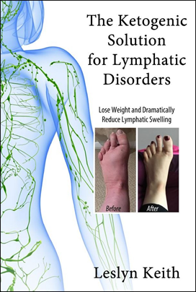
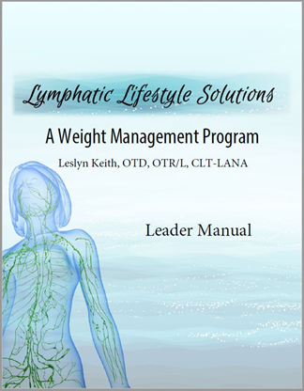
Disclosures
Program
Lymphatic Lifestyle Solutions: A Weight Management Program
Book
The Ketogenic Solution for Lymphatic Disorders:
Lose Weight and Dramatically Reduce Lymphatic Swelling

Slide 3

Ketogenic Way of Eating
Real Food Diet
Carbohydrate Restriction
Healthy Fats
Moderate Protein

Slide 5
Results
Weight | -11.42 lbs | p<.001
BMI | -2.0 | p<.001
Waistline | -3.75 cm | p=.025
% Body Fat | -1.23 | p=.133
Limb Volume | -698.9 ml | p<.001
LLIS | -12.44 | p=.002
OWLQOL | +23.98 | p<.001
WRSM | -13.14 | p<.001
COPM(P) | +2.22 | p<.001
COMP(S) | +2.66 | p<.001

Slide 6
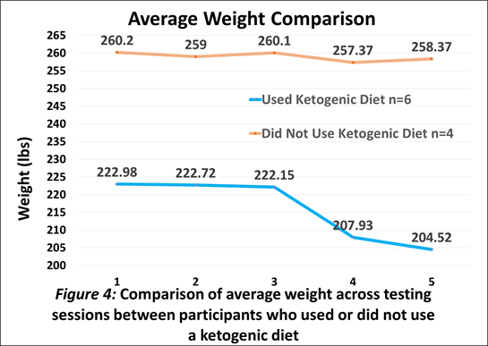
Average weight loss without ketogenic diet = 1.36 lbs.
Average weight loss with ketogenic diet = 18.09 lbs. (8.1% of baseline weight)

Slide 9
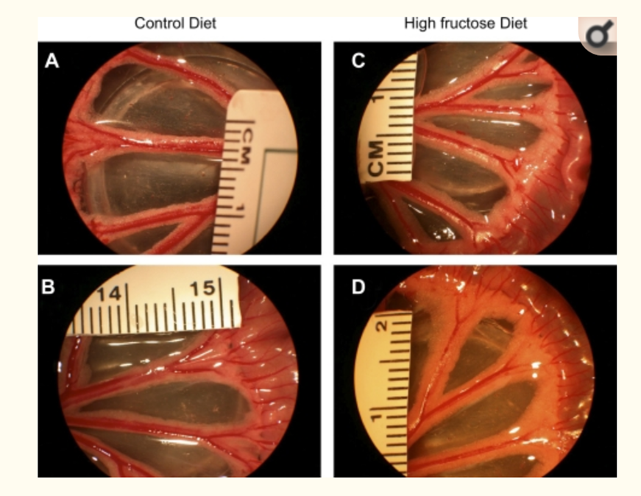
Carbohydrates are Inflammatory
Impairments in the intrinsic contractility of mesenteric collecting lymphatics in a rat model of metabolic syndrome, Zawieja, SD et al. (2012), Am J Physiol Heart Circ Physiol 302, H643–H653.
Notes:
Metabolic Syndrome induced by high fructose diet resulted in 50% reduction in transport capacity of lymphatics in rats

Slide 10
WISER Randomized Clinical Trial
No correlation between weight loss and limb volume reduction
Control Group
Compression Sleeve
Weight Loss Group Compression Sleeve
Nutrisystem + Fruits and Vegetables
Exercise Group
Compression Sleeve
Weight Loss & Exercise Group
Compression Sleeve
Effect of Home-Based Exercise and Weight Loss Programs on Breast Cancer–Related Lymphedema Outcomes Among
Overweight Breast Cancer Survivors: The WISER Survivor Randomized Clinical Trial. Schmitz et al. (2019), JAMA Oncology, E1-E9.

Slide 11
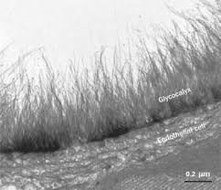
Carbohydrates are Inflammatory
Hyperglycemia increases glycocalyx permeability
Short-term hyperglycemia increases endothelial glycocalyx permeability and acutely decreases lineal density of capillaries with flowing red blood cells, Zuurbier, CJ et al. (2005), J Appl Physiol, 99, 1471–1476.
Notes:
Hyperglycemia results in changes in the barrier function and/or the volume of the glycocalyx

Slide 12
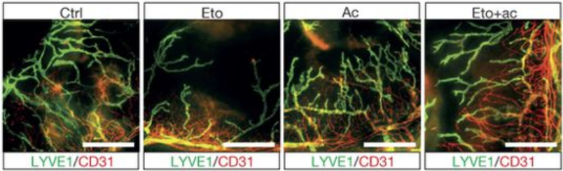
Lymphatic System Runs on Fat
The role of fatty acid β-oxidation in lymphangiogenesis. Wong, BW, et al. (2017), Nature, 542(7639), 49-54.
Notes:
Etomoxir inhibits fatty acid oxidation.

Slide 13
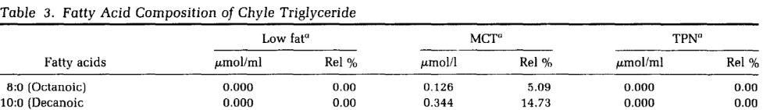
Lymphatic System Runs on Fat
MCTs found in lymph!
Dietary Modification of Chyle Composition in Chylothorax. Jensen et al. (1989), Gastroenterology 97,761-5.
Notes:
Case study that compared low fat, MCT only, and total parenteral nutrition in sequence

Slide 14
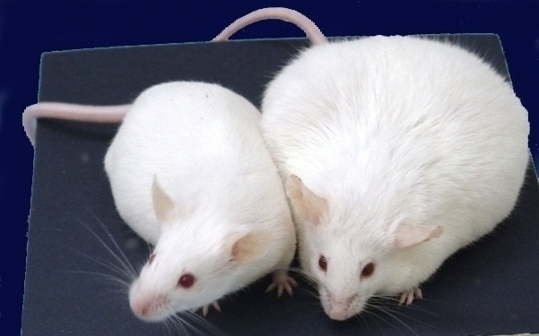
Lymphatic System Runs on Fat
Obesity, not a high fat diet, impairs lymphatic function and aggravates lymphedema. (Gousopoulos et al 2017; García Nores et al 2016)

Slide 15
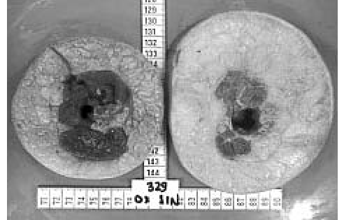
Acute inflammation causes fat break down
Chronic inflammation results in increased fat storage
(Harvey, 2008; Harvey & Gordon, 2012)

Slide 16

KETOLYMPH Study
Randomized trial
100 participants with lymphedema
48 weeks (24 strict keto, 24 modified Atkins)
https://clinicaltrials.gov/ct2/show/NCT03991897
Notes:
Belgium research group, Began in May 2019, concludes in 2023

Slide 17
Kelly Bell
51-year-old male
Military career
Triathlete
2005 - Treated for misdiagnosed reflux with injection of polymer which infiltrated thoracic duct
Symptoms:
Weight gain
Swelling to legs, arms, trunk, R side of
face/neck
Difficulty breathing – CPAP, O₂
Severe pain
GI issues
Suicidal ideation
Suggested treatment –
Low fat, low calorie diet
Exercise

Slide 18
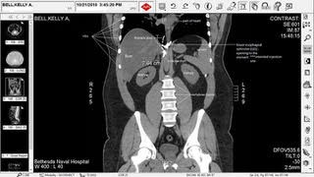

Slide 19
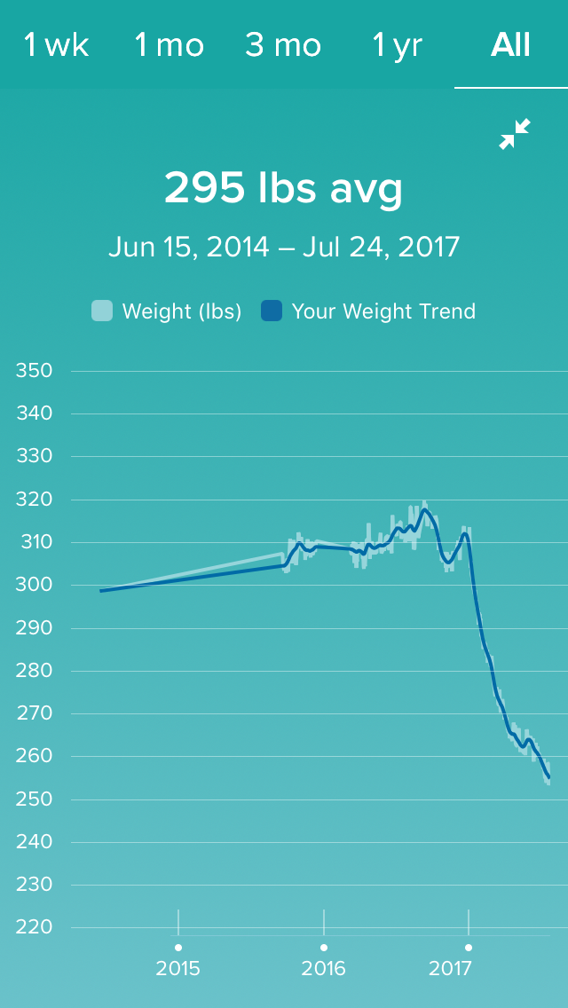
Began ketogenic way of eating January 2, 2017
Results
Weight decrease
317 lbs. to 253 lbs.
Currently = 230 lbs.
87 lbs. decrease
Breathing = d/c’d O₂ & CPAP
Increased energy and vitality
Improved cognition
Improved bowel function
Decreased pain
Decreased edema

Slide 20
Improved Lipid Profile
 | 3/15/2016 | 3/1/2017 | 5/29/2019
Total Cholesterol | 187 | 181 | 212
Triglycerides | 208 | 111 | 107
HDL Cholesterol | 28 | 35 | 40
LDL Cholesterol | 117 | 124 | 150
HbA1c | 5.8 |  | 5.3
Tg/HDL ratio | 7.49 | 3.17 | 2.67

Slide 21
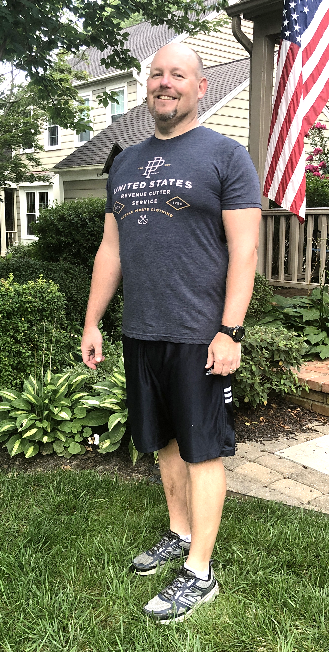

Slide 22
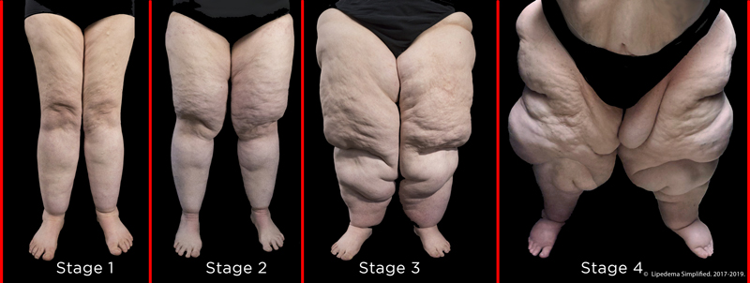
Can Keto Work for Lipedema?
Disproportionate deposition of fat to lower half of body
Hypersensitivity/pain
Easy bruising
Widely believed to be resistant to diet and exercise

Slide 23
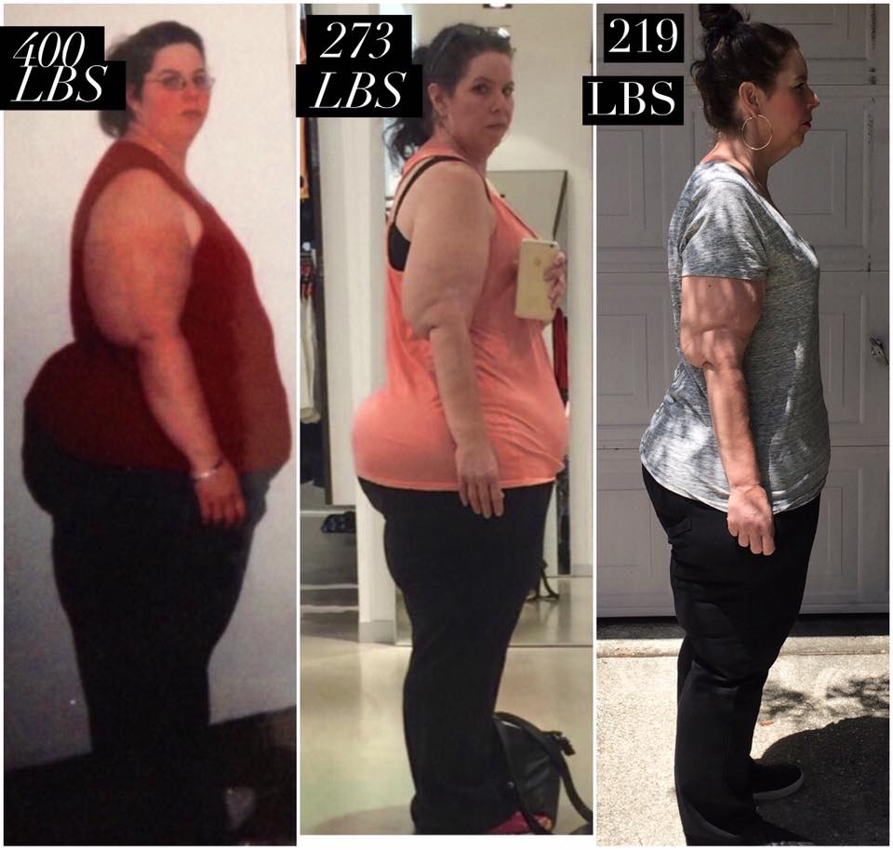
Ketogenic Solution
for Lipedema
Fat loss on lower body
Decreased or resolved pain
Increased energy
Decreased brain fog
Edema reduction or resolution
Absence of hunger
181 lbs in less than 2 years “No surgery, no exercise, just [ketogenic] food.”

Slide 24

LIPODIET Study
Effect of a ketogenic diet on pain, body composition and quality of life for women with lipedema
Notes:
University of Oslo, Norway, 6-week intervention followed by 6 weeks on standard Norwegian diet, Completed in January 2019

Slide 25
LipoDiet Study
Results
Participants/Methods
Weight loss at week 7 (9.5 lbs), maintained at week 13
Significant decrease in hip measurements at week 7, no decrease at week 13
triglycerides at week 7
at week 13
pain at week 7, return of pain to prior levels at week 13 despite maintenance of weight loss
9 women diagnosed with lipedema
Average age 47 years
Average weight 225 lbs
7 weeks ketogenic diet
6 weeks standard Norwegian fare

Slide 26


46-year-old female
Highest non-pregnant weight: 265 lbs.
BMI: 41.5
Waist Measure: 35”
Hip Measure: 53”
Migraines 20 days/month
Unmanaged PCOS
Hypercholesterolemia
Borderline hypertension
Lymphedema
Lipedema
Mende Staggs

Slide 27


Loss of Faith in Medical Community
Powerless to Make Change
Self-Blame for Failure of Multiple Diets
Hopelessness
Mixed Emotions with Lipedema Diagnosis

Slide 28
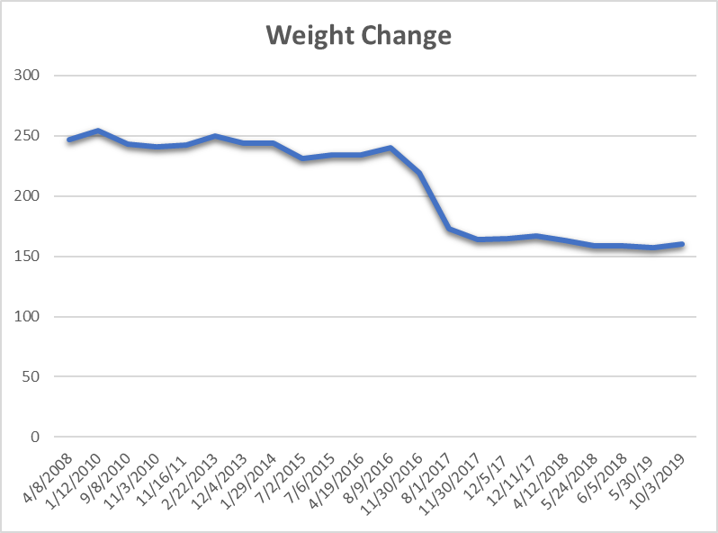
Began ketogenic way of eating September 2016
Results
Weight decrease
254 lbs. to 157 lbs.
97 lbs. decrease
Waist – 25” (10” decrease)
Hip – 38” (15” decrease)
Clothing size 22 to size 6
Migraines have resolved
Swelling & pain well controlled
PCOS well-managed
Lowered blood pressure
Weight (pounds)
Began Keto Diet

Slide 29
Improved Lipid Profile
 | 11/30/2016 | 10/26/2018 | 5/3/2019
Total Cholesterol | 206 | 185 | 178
Triglycerides | 105 | 53 | 80
HDL Cholesterol | 52 | 72 | 54
LDL Cholesterol | 133 | 102 | 108
Tg/HDL ratio | 2.01 | 0.73 | 1.48

Slide 30




Slide 31


Slide 32
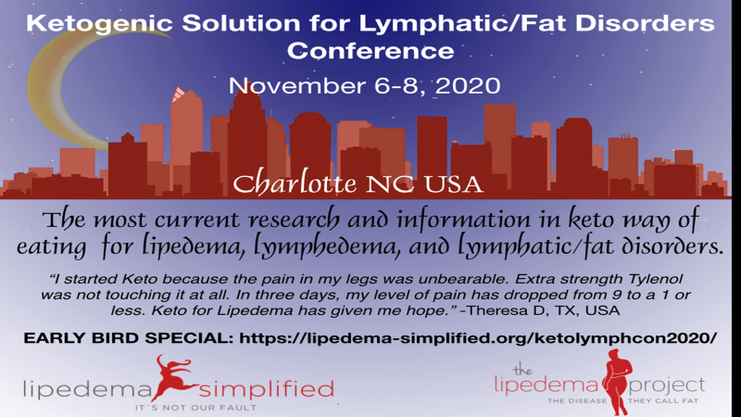

Slide 33
Resources
https://www.leslynkeith.com/
Lymphatic Education & Resource Network (LE&RN) Symposium Series (Dr. Eric Westman, Dr. Leslyn Keith) https://lymphaticnetwork.org/
Lipedema Simplified (keto for lipedema page)
https://lipedema-simplified.org/keto/
Facebook groups:
Keto and Fasting for Lymphedema
Keto WOE for Lipedema

Slide 34
Thank you!
leslynkeithot@gmail.com
https://www.leslynkeith.com/

